Slide 1
IMAGE PROCESSING SYSTEM FOR LEATHER DEFECT IDENTIFICATION
SELF STUDY
GUIDE:- PROF. D.K.CHATURVEDI
SUBMITTED BY:- MEHER KUMAR
ROLL NO:-1906417
M-TECH PART TIME 6 TH SEMESTER

Slide 2
The defects on a leather surface may be caused by the poor material handling process during the production and manufacturing stages. It is essential to eliminate the natural variations and artificial injuries on the leather surfaces, in order to control the quality of the products and achieve customer satisfaction. To date, the visual inspection of the leather defects is performed manually by human operators. Thus, this study aims to introduce an automatic defect detection technique by employing a deep learning method. Specifically, the proposed method consists of two stages: classification and instance segmentation. The former stage distinguishes whether the piece of the leather sample contains a defective part or not, whereas the latter is to localize the precise defective location. To accomplish the tasks, the dataset is first collected under a proper laboratory environment.

Slide 3
The purpose of this self study is to use the image processing to perform some operations on an image, in order to get an enhanced image or to extract some useful information from it. It is a type of signal processing in which input is an image and output may be image or characteristics/features associated with that image. Nowadays, image processing is among rapidly growing technologies. It forms core research area within engineering and computer science disciplines too. Image processing basically includes the following three steps:
. Importing the image via image acquisition tools;
. Analysing and manipulating the image;
. Output in which result can be altered image or report that is based on image
analysis.
There are two types of methods used for image processing namely, analogue and digital image processing. Analogue image processing can be used for the hard copies like printouts and photographs. Image analysts use various fundamentals of interpretation while using these visual techniques. Digital image processing techniques help in manipulation of the digital images by using computers.The three general phases that all types of data have to undergo while using digital technique are pre-processing, enhancement, and display, -information extraction.
Image processing involves changing the nature of an image in order to either
Improve its pictorial information for human interpretation
Render it more suitable for autonomous machine perception.
Image processing has an enormous range of applications. Almost every area of science and technology can make use of image processing methods.

Slide 4
Leather defects are imperfections occurring in the grain surface or surface of the hideor skin, which ultimately result in the unsightly appearance and weakness of the resultant leather. Defects that appear in the finished leather are the result of damage to the raw skin, poor storage or improper processing during manufacturing.
Dye transfer from leather is the result of insufficient colour fixation. For example, it can be caused by excessively concentrated dyes or insufficient washing after the dyeing stage. If the colour concentration is too high, bronzing can also occur.
In the liming process, excessive contact with fresh air can cause liming stains on the grain side of the leather.
Irregular blood stains are caused by lack of drainage of the salt liquor after the preservation of the hides by salting.
Colour defects can occur if the applied colouration does not cover uniformly, especially on already damaged areas.
Fat marks on leather occurs where leathers have a high fat content, such as sheep leather.
Tannin stains are caused by uneven concentration of the tanning agent in the leather production.
Basically leather is the skin of animals after it is treated to many processes that refine it and beautify it.
The four things which decide the quality of leather are:-
.Tanning process . Type of hide .Location of the cut .The thickness of the leather.

Slide 5
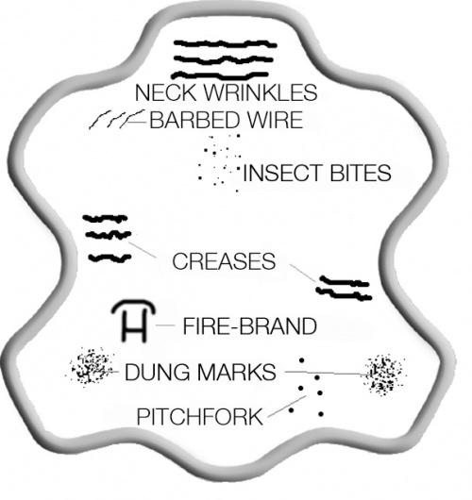
Below are some examples, which are typical in practice and make the leather partially unusable and cause higher waste. Many of the skin damages are not detectable on the rawhide. They only become apparent after the first processing stages in the tannery.
Barbed wire scars and scratches:-
In addition to barbed wire scars, animals can incur a whole range of scars and scratches caused by contact with sharp objects, such as thorns or branches. The number of scars, their length, width and spread across the skin are all factors that determine the extent of the use of such leather.
Pitchfork injuries:-
Pitchfork injuries, as the term suggests, are caused by prodding the animals with sharp objects. They are also known as goad marks. Where such injuries have occurred frequently and healed badly, the leather is unusable.

Slide 6
Barbed wire scars and scratches:-
In addition to barbed wire scars, animals can incur a whole range of scars and scratches caused by contact with sharp objects, such as thorns or branches. The number of scars, their length, width and spread across the skin are all factors that determine the extent of the use of such leather.
Pitchfork injuries:-
Pitchfork injuries, as the term suggests, are caused by prodding the animals with sharp objects. They are also known as goad marks. Where such injuries have occurred frequently and healed badly, the leather is unusable.
Warts:-
Cattle get warts, just like humans. During the tanning process, leather goes through so many machines that warts often tear. Even without tearing, warts deteriorate the skin quality.
Horn scratches and blows:-
Injuries from horns occur during bullfights and leave significant scars.

Slide 7
Surgical scar:-
Animals can also have surgical scars which are visible on the leather.
Neck wrinkles – Creases:-
Neck wrinkles and creases are a normal phenomenon and do not affect the value of the leather. They occur in cattle in the neck and abdomen, where the connective fibres are longer. Neck wrinkles naturally occur in a hide as a result of the neck stretching and contracting. The grain pattern is stronger in this area.
When cutting the leather, it is essential to make sure that the graining on the finished object is symmetrical. However, where there is varied graining in an object, this usually an intentional effect.
Insect bites:-
Tick bites and stings of other insects appear as small surface damages on the skin.

Slide 8
IMAGE PROCESSING
Digital image processing is the use of digital computer to process digital images through an algorithm .example:- Adobe photoshopping , Matlab as a subcateogary of digital signal processing. Digital image processing has many advantages over analog image processing .It allows a much wider range of algorithms to be applied to the input data and can avoid problems such as the build up of noise and distortion during processing .Since images are defined over two dimensions (perhaps more) digital image processing may be modelled in the form of multidimensional systems.
The generation and development of digital image processing are mainly affected by three factors :
First:- the development of computers
Second:- the development of mathematics especially the creation &
improvement of discrete mathematics theory.
Third:- the demand for a wide range of applications in environment , agriculture
, military ,industry and medical science has increased .
Steps in Image Processing:-
Step1- Image Acquisition( the image is captured by the sensor)
Step2-Image Enhancement
Step3- Image restoration
Step4- Colour Image Processing
Step5- Wavelets
Step6- Compression
Step7-Morphological Processing
Step8- Image Segmentation

Slide 9
Digital image processing can increase visibility of details , can reduce noise , can adjust &optimize contrast . If input is image & description then output is also image & with description . Along with digital image processing done, with computer vision & computer graphics & artificial lintelligence First of all there is problem domain .The image sensors after sensing the image with image processing hardware & image processing software applied on , computer the hard copy device & also a mass storage device display image .Image captured by camera &sent to digital image processing system that gives its output as an processed image . After accquisition of image , processing done & a comparison is made based on knowledge & associative storage resulting as an output image .
Image processing which is a low level process reduce noise , does contrast , enhancement , image sharpening .Then image analysis done which is a mid level process . It does Segmentation & Classification . Then there is vision derived which is a high level process . It is making sense of an ensemble of recognised objects .
Some techniques that are used for Digital image processing are:-
Anistropic Diffusion
Hidden Markov Models
Image Editing
Image Restoration
Independent Component Analysis
Linear Filtering
Neural Networks
Partial Differential Equations

Slide 10
OTHER METHODS:-
KERNEL IMAGE PROCESSING:-
In image processing , a kernel convolution matrix or Mask is a small matrix . It is used for blurring , sharpening ,edge detection and more .This is accomplished by doing a convolution between a kernel & an image .They are also used in machine learning for ‘feature extraction’, a technique for determining the most important portions of an image.
Kernel filter provide low & high Pass filtering (smoothing & sharpening respectively) using a kernel . The filter removes any pixels that are darker than a certain fraction of the darkest Neighboring pixel .
The term “ filter “ is for 3d Structures of multiple kernels stacked together . For a 2d filter , filter is same as a kernel . But for a 3d filter & most convolutions in deep learning , a filter is collection of kernels .
SOBEL OPERATOR:-
Sometimes called the sobel fieldman operator or sobel filter is used in image processing & computer vision particularly within edge detection algorithm where it creates an image emphasising edges . It is named after Irwin sobel & gary feldman . At each point in image, the result of the sobel feldman operator is either the corresponding gradient vector or the norm of this vector . The sobel feldman operator is based on convolving the image with a small separable & integer valued filter in the horizontal & vertical direction & is therefore relatively inexpensive in terms of computation . On the other hand , the gradient approximation that it produces is relatively crude , in particular for high frequency variation in the image .

Slide 11
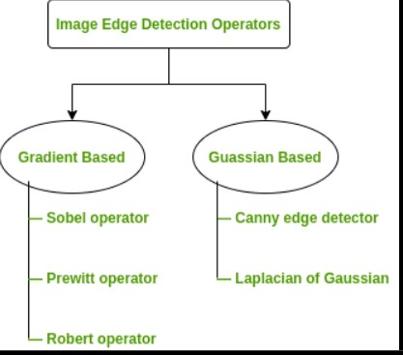
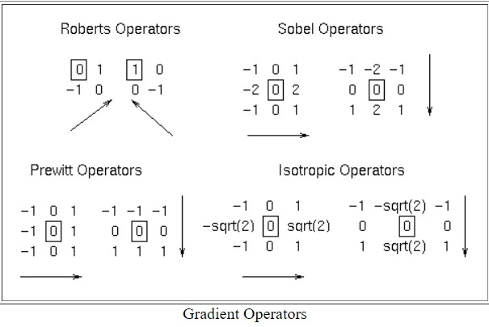
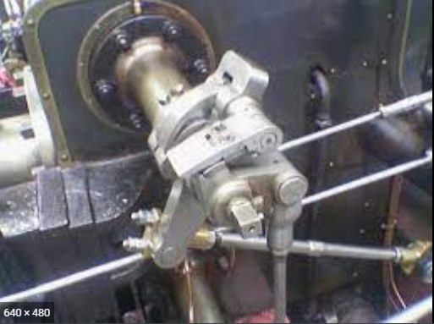

Slide 12
EFFECTIVE MATLAB APPLICABILITY:-
Color-Based Segmentation Using K-Means Clustering:-
K-means clustering aims to partition data into k clusters in a way that data points in the same cluster are similar and data points in the different clusters are farther apart. Similarity of two points is determined by the distance between them. The similarity measure is at the core of k-means clustering. The k-means clustering algorithm attempts to split a given anonymous data set (a set containing no information as to class identity) into a fixed number (k) of clusters. The resulting classifier is used to classify (using k = 1) the data and thereby produce an initial randomized set of clusters. The problem is computationally difficult (NP-hard); however, efficient heuristic algorithms converge quickly to a local optimum. K-Means clustering tends to find clusters of comparable spatial extent, while the Gaussian mixture model allows clusters to have different shapes .
K-Means Clustering processed as follows:-
Step 1: Choose the number of clusters k. ...
Step 2: Select k random points from the data as centroids. ...
Step 3: Assign all the points to the closest cluster centroid. ...
Step 4: Recompute the centroids of newly formed clusters. ...
Step 5: Repeat steps 3 and 4.

Slide 13
Commands:-
gabor - Create Gabor filter or Gabor filter bank
Imgaborfilt - Apply Gabor filter or set of filters to 2-D image
cat - Concatenate arrays
bsxfun - Apply element-wise operation to two arrays with implicit expansion enabled
repmat - Repeat copies of array
kmeans - k-means clustering
rgb2gray - Convert RGB image or colormap to grayscale
imsegkmeans - K-means clustering based image segmentation
label2rgb - Convert label matrix into RGB image
meshgrid- Provides the mesh Plot
FeatureSet- Provide high level feature
pca(X)- Provide pca analysis
Repmat- Provides Repetetion of copies of Arrays .
Imshowpair- Provides Montage of multiple images .
Labeloverlay- Provides overlaying of label matrix .

Slide 14
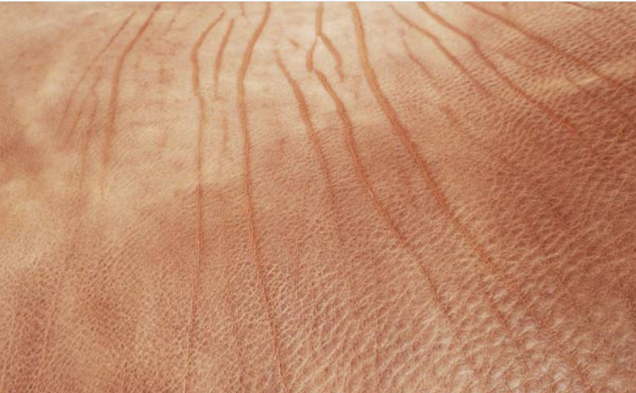
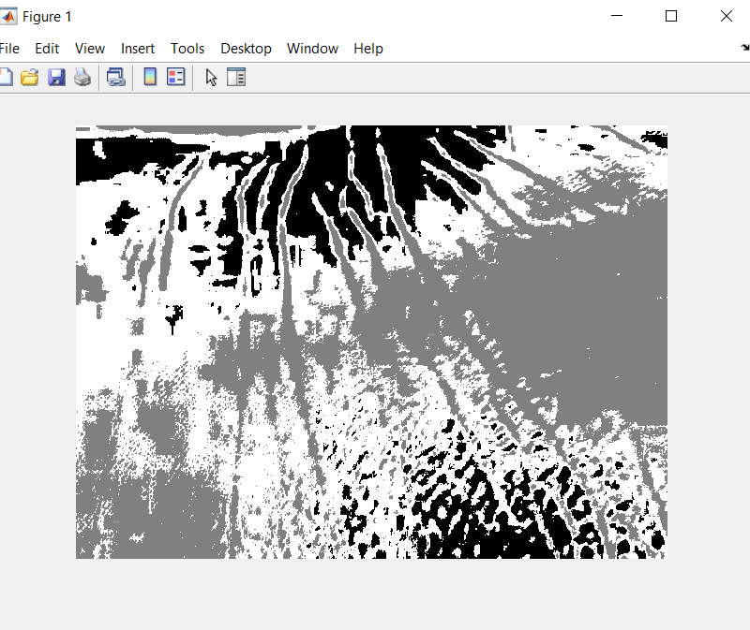
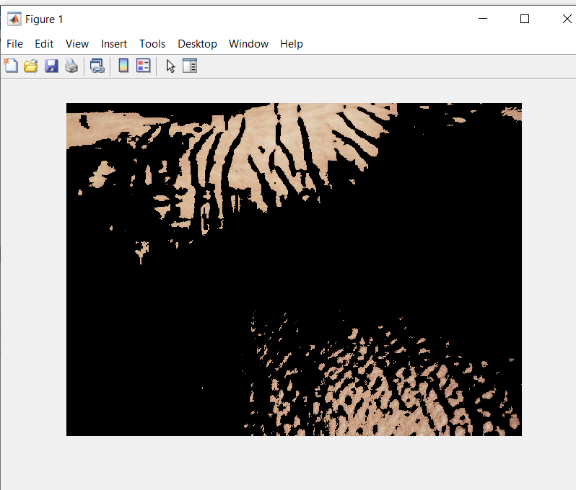
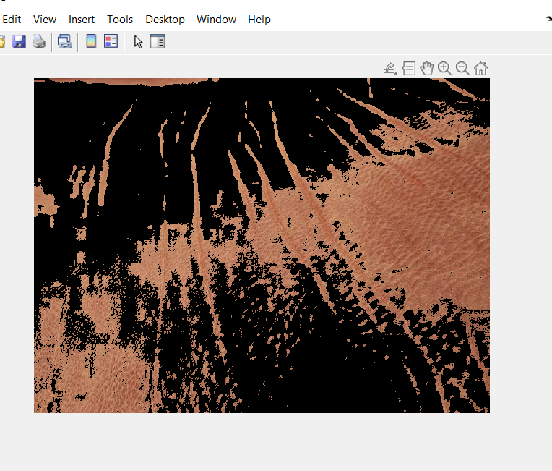
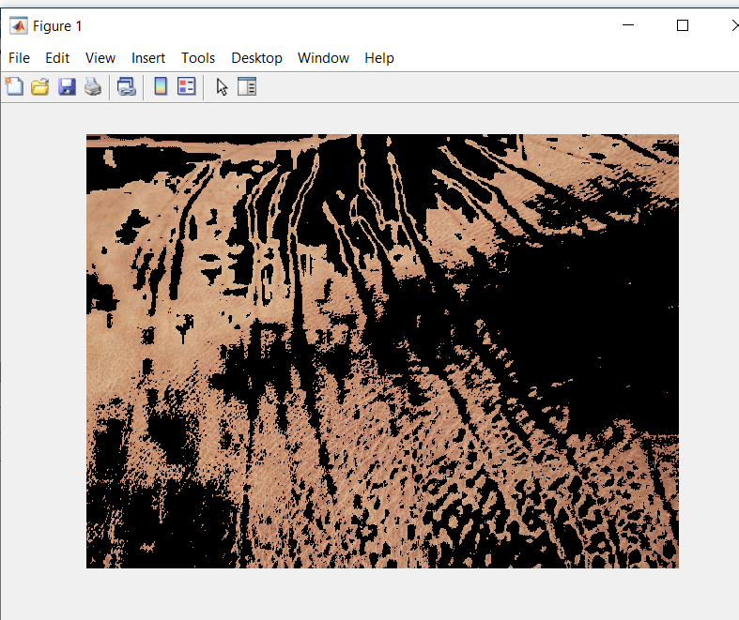
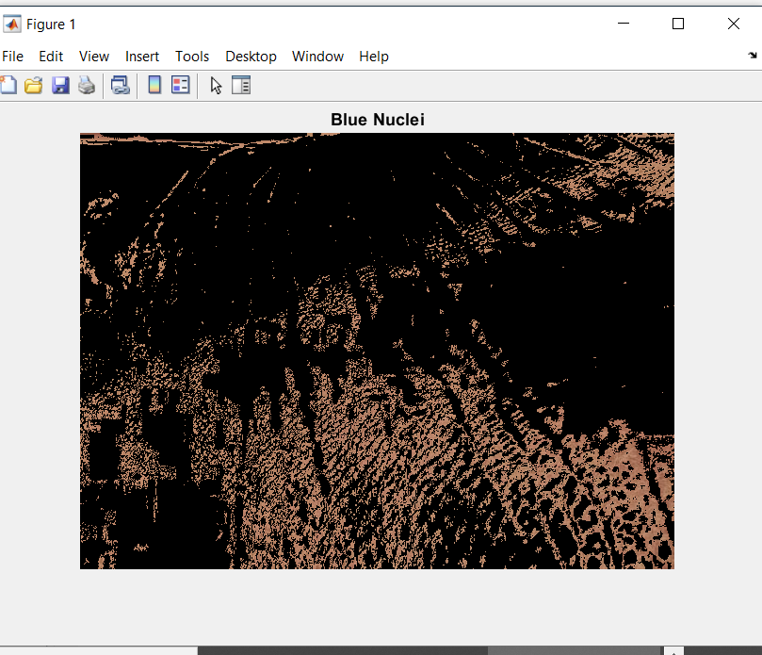
DIFFERENT IMAGES ON WRINKLES ON LEATHER

Slide 15
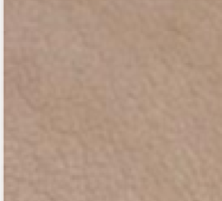
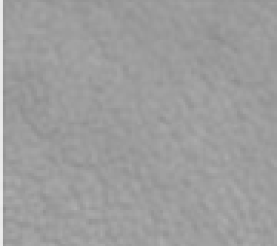

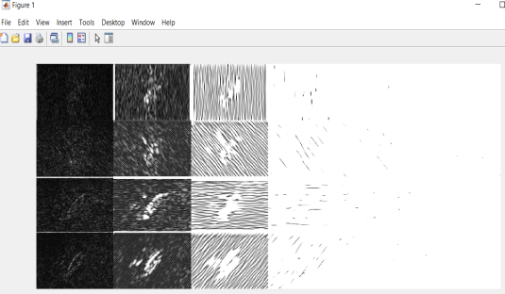
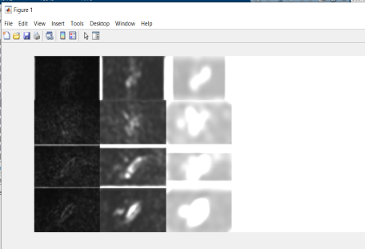
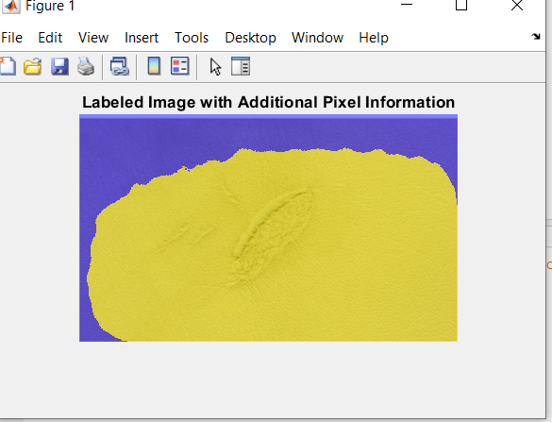
MATLAB ENABLING TEXTURE SEGMENTATIN USING GABOR FILTERS:-
Texture segmentation is done to identify regions based on their texture. The goal is to segment the different or irregular pattern from the beckground or required pattern. The segmentation is visually obvious because of the difference in texture between the two.
K-means iterative clustering algorithm applied to image texture segmentation:-
The K-means algorithm is a robust, unsupervised clustering algorithm applied here to the problem of image texture segmentation. The K-Means algorithm involves two steps. First, K-means is applied. Second, the K-means class assignments are used to estimate parameters required to improve the solution. Gabor filters and co-occurrence probabilities are used as texture features.
IMAGES SHOWING PITCH FORK INJURIES ON LEATHER

Slide 16
RESULTS & DISCUSSION
In first attempt using the L*a*b* color space & K- means clustering which use Eucledian distance metric to segment colors & converting into clusters obtaining blue object in one of them . After extracting brightness level of pixel then thresholding with global threshold getting dark blue cell nucleias end result . The Wrinkles & Horn scratches on leather which are major defect are clearly identified and marked using this method but for the small defects like Pitch fork injuries ,this method is not found practically generous . For this , using gabor filter followed by K-means clustering & then choosing sigma & determining gabor magnitude & then obtaining additional pixel information after segmentation proved effective . Thus second method is more applicable for fine defects.

Slide 17
THANK YOU

