Slide 1
QUALITY CONTROL FOR EVA SHOE PRODUCTION
COURSE CODE:- PEE411
MINOR PROJECT(GUIDE:-Prof.d.k.chaturvedi
SUBMITTED BY:- MEHER KUMAR
M-TECH PART TIME
6TH SEMESTER
3RD YEAR

Slide 2
.
The Manual defect inspection and analysis of removal of EVA MATERIAL from mould becomes tedious and inaccurate attribute to the fact that human error is evident . Furthermore such human imperfected diagnosis slows down the production and becomes labour intensive . This describes the automation of mould cleaning for increasing the productivity of shoe industry with reduced human workload. This becomes the vital bottlemark in the entire production process due to computerized diagnostics through image processing , segmentation and Modelling . Image Processing techniques for automated detection and diagnosis which will be synchronized with Matlab software. This results to detect defects and grade production automatically & thus solving the problem of such misjudgement and thereby high costs etc , caused by manual inspectors

Slide 3
PROBLEM STATEMENT :-The material hanging on moulds after EVA shoe removal , is to be removed before next batch to be prepared otherwise the left hanging material will disrupt the finess and smoothness of the prepared shoe of the incoming new batch .
OBJECTIVE :- The human error is evident in inspection & detection . So automation in shoe industry for defect inspection and analysis is must , resulting in quality in production and also time saving methodology in mass production . The purpose of this project is to design the system which monitors whether the moulds are cleaned after operated upon by EVA machine to obtaine good shoes as end result . In this work the identification of clean and unclean moulds is focused on the methods using MATLAB. First we extract certain features from the input mould image, later using different method like thresholding, segmentation, k-means clustering and thus obtain related databases. From the proposed method able to identify the cleaned and uncleaned moulds with a very high accuracy successfully using image processing.

Slide 4
The developed system based on two cameras following the mould contour . The work focusses on image processing algorithm for detecting left EVA material on moulds after removal of prepared shoe & Matlab programming issues related to the path following optimisation which have been sucessfully tested with programming. This describes the automation in increasing the production with a reduced human workload . Using MATLAB software as a tool in image processing can find whether the moulds are cleaned or uncleaned using various algorithms . In proposed Methodology , We use Image Acquisition , preprocessing , RGB image , background subtraction , Gray image , Binary image , segmentation , K-Means Clustering Algorithm and Feature Matching .

Slide 5
The top five common quality defects that are unique to shoes are :-
Excess Glue, Wax or Oil
Degumming or Weak Cementing
Abrasion Marks
Asymmetry in Shoes
Incorrect Sizing
I have worked on Image processing in Matlab with Gabor filtering , k- means clustering and segmentation to detect left EVA material which remains hanging on mould after removal of prepared shoe .
Gabor filtering is a widely adopted technique for texture analysis.
Gabor filters show a strong dependence on a certain number of parameters, the values of which significantly affect the outcome of the classification procedures on the smoothing parameter of the Gabor filters. The correlation between the number of frequencies and orientations used to define a filter bank and the percentage of correct classification affect the smoothing parameter of the Gabor filters directly .

Slide 6
Clustering technique is active research field in machine learning. In Document Image Segmentation, clustering technique is one of the most famous, simple and easy to implement technique.
The K-Mean clustering IS the process of grouping samples so that the samples are similar within each group .It is an unsupervised algorithm used to segment the interest area from background .Unsupervised algorithm ia a type of machine learning in which the algorithm is not provided with any preassigned labels or scores for the training data .The unsupervised algorithm first self discover any naturally occuring patterns in the training data set
Segmentation is nothing but making the part of image or any object.
Image segmentation is most of judging or analyzing function in image processing and analysis. Image segmentation refers to partition of an image into different regions that are homogenous or similar and inhomogenous in some characteristics.
Image segmentation results have an effect on image analysis and follows higher order tasks. Image analysis includes object description and representation, feature measurement. Higher order task follows classification of object.. Hence characterization, visualization of region of interest in any image, delineation plays an important role in image segmentation.

Slide 7
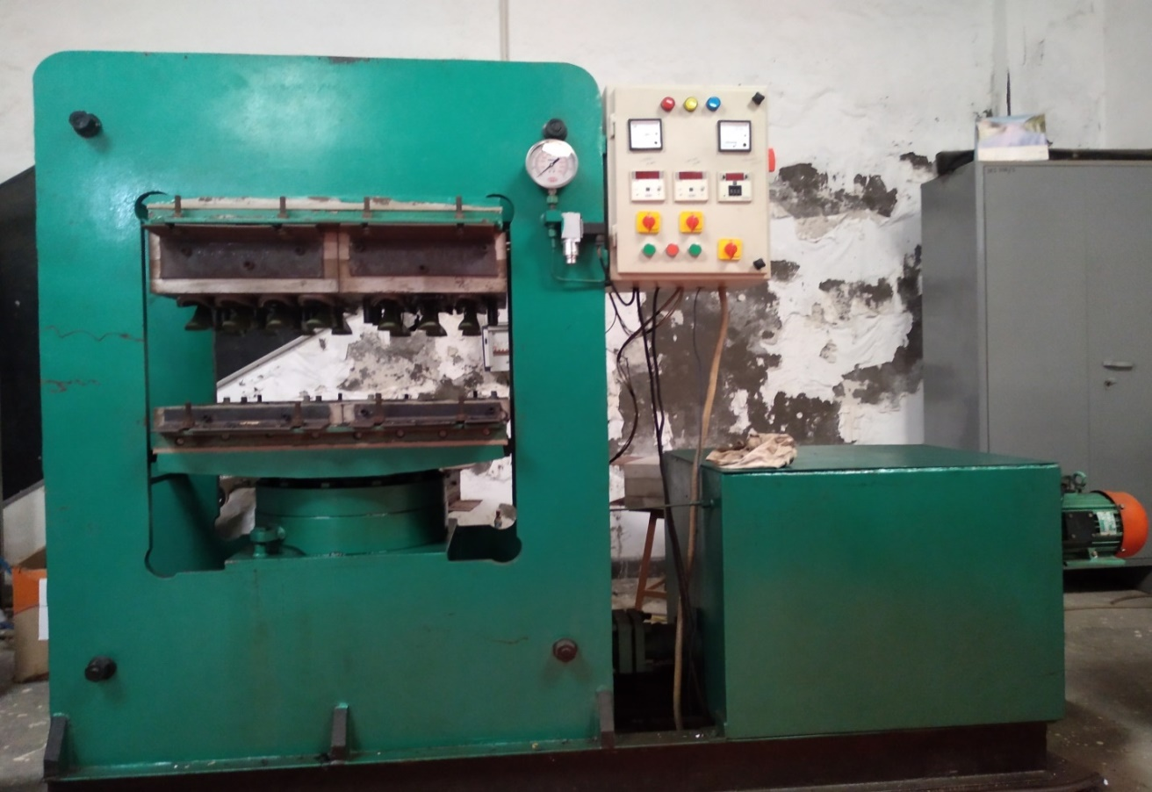
EVA COMPRESS MOULDING MACHINE FOR SHOE PREPARATION
MATERIAL:- EVA material grade 900(Ethyl Vinyle Acetate)
MELT:- LOWER PLATE(SOUL) - Thick more- (134+7) degre centigrate
UPPER PLATE(UPPER PORTION) - Thick less - 134 degre centigrate
PRESSURE- 1500 to 2000 pound square inch(less than 1 tonne square inch) Hydraulic
GRANULES- Black & White
TIMER - 15 minutes for big size & 8-10 minutes for small size
MOULDS SIZE AVAILABLE- 6,7,8,9,10 no. moulds

Slide 8
First I Read image from graph & then Returns a row vector whose elements are the lengths of the corresponding dimensions of image . Then I Resize image & Convert RGB image to gray scale . An RGB image is a three dimrensional byte array that explicitly stores a color value for each pixel . RGB images are made up of width , height & three channels of color information . Scanned photographs are commonly stored as RGB images .Then Start image segmentation row wise & columnwise . After it Sample wavelength in increasing powers of two starting from 4/sqrt upto the hypotenuse length of the input image & then Rounding it towards the negative infinity of the value . Then using Gabor filters which Provide gabor magnitude in terms of wavelength & energy . Then I choose sigma wavelength which is matched to gabor filter, extracting each feature . A smoothing term K equal to 3 is introduced whose value determining how much smoothing is applied to the gabor magnitude response . Then I create a mesh plot which is a three dimensional surface having solid edge colors &no face colors .& extracting high level feature from data of concatenate arrays .Then I applied Element wise opearation to two arrays with implicit expansion enabled and does principle componenet analysis of raw data . By K- Means clustering , partionind n-by-p matrix into K clusters obtaining n-by-1 vector containing cluster indices of each observation .Then doea piecewise distribution segmentation over copies of arrays .After doing K-Means clustering based image segmentation and overlaying label matrix region on 2-d image & obtaining labled image with additional pixel information .
.

Slide 9
Commands:-
gabor- Create Gabor filter or Gabor filter bank .This MATLAB function creates a Gabor filter with the specified wavelength (in pixels/cycle) and orientation (in degrees).
imgaborfilt - Apply Gabor filter or set of filters to 2-D image.This MATLAB function computes the magnitude and phase response of a Gabor filter for the input grayscale image A.
cat - Concatenate arrays.
This MATLAB function concatenates B to the end of A along dimension dim when A and B have compatible sizes (the lengths of the dimensions match except for the operating dimension dim).
bsxfun- Apply element-wise operation to two arrays with implicit expansion enabled
This MATLAB function applies the element-wise binary operation specified by the function handle fun to arrays A and B.
repmat- Repeat copies of array. This MATLAB function returns an array containing n copies of A in the row and column dimensions.

Slide 10
Kmeans- - k-means clustering .
This MATLAB function performs k-means clustering to partition the observations of the n-by-p data matrix X into k clusters, and returns an n-by-1 vector (idx) containing cluster indices of each observation.
Rgb2gray - Convert RGB image or colormap to grayscale
This MATLAB function converts the truecolor image RGB to the grayscale image I.
Imsegkmeans - K-means clustering based image segmentation
This MATLAB function segments image I into k clusters by performing k-means clustering and returns the segmented labeled output in L.
label2rgb - Convert label matrix into RGB image
This MATLAB function converts a label image, L into an RGB color image for the purpose of visualizing the labeled regions.
Meshgrid - Provides the mesh Plot
This MATLAB function creates a mesh plot which is a three dimensional surface having solid edge colors & no face colors
FeatureSet - Provide high level feature
This MATLAB function Extracting high level feature from data of concatenate arrays .

Slide 11
pca(X)- Provide pca analysis
This MATLAB function Does principle component analysis of raw data .
Repmat- Provides Repetetion of copies of Arrays .
This MATLAB function Repeat copies of arrays .
Imshowpair- Provides Montage of multiple images .
This MATLAB function display multiple image frames as rectangular montage.
Labeloverlay- Provides overlaying of label matrix .
This MATLAB function provides Overlay label matrix regions on 2-D image.

Slide 12
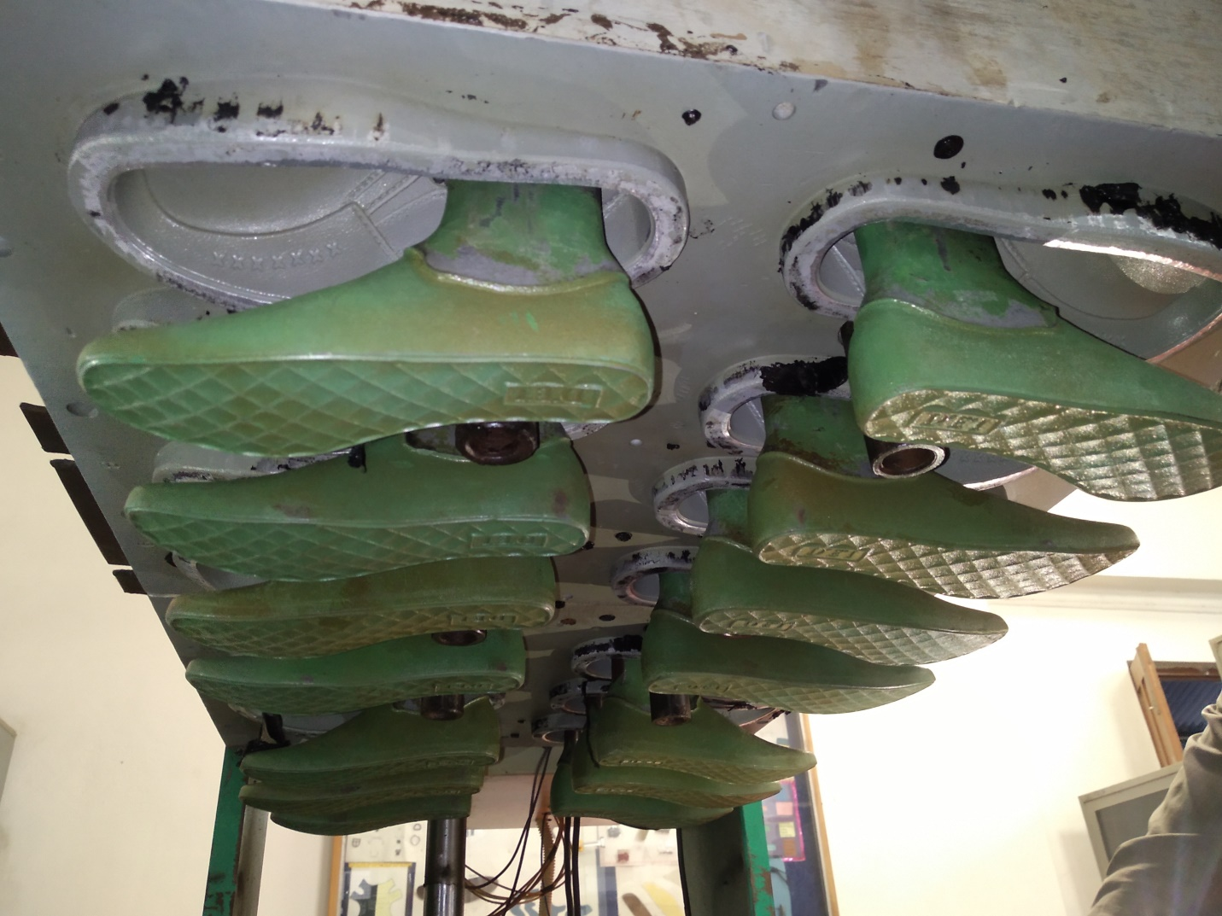
DYE FIXED AT UPPER SECTION

Slide 13
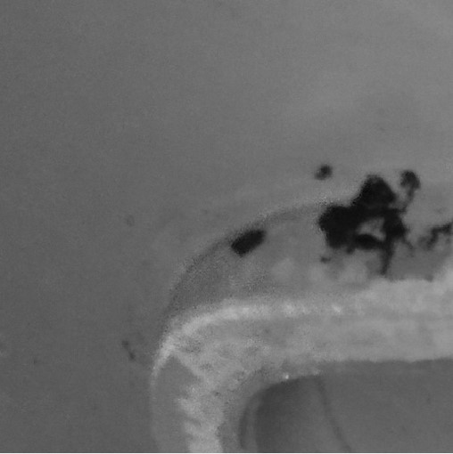
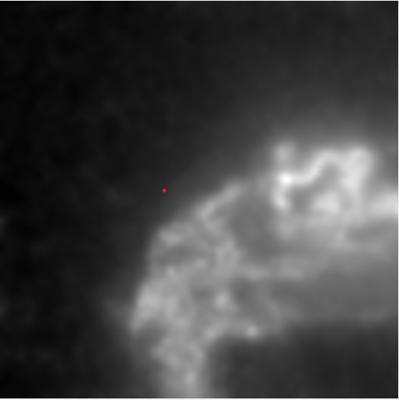
GREY PICTURE OF SECTION OF A k-MEANS OUTPUT OF THE PICTURE MOULD WHERE EVA MATERIAL IS HANGING AFTER REMOVAL OF PREPARED SHOE FROM MOULD

Slide 14
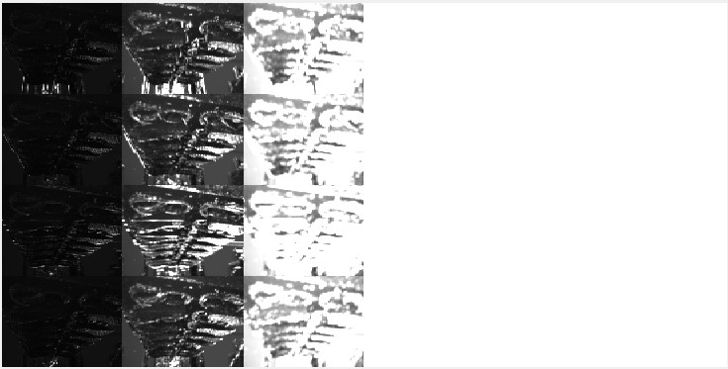
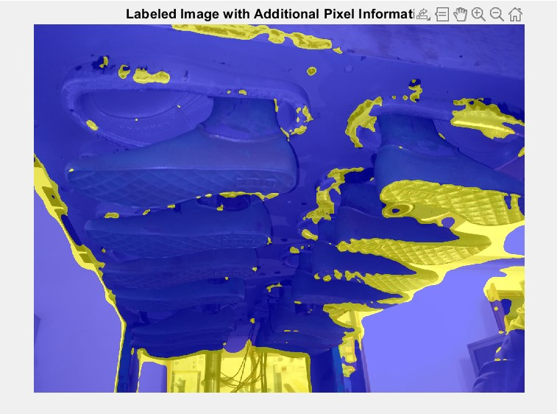
K- MEANS CLUSTERING BASED LABLED IMAGE WITH ADDITIONAL PIXEL INFORMATION IMAGE SEGMENTATION

Slide 15
CONCLUSION
“In this project the identification of cleaned and uncleaned moulds based on quality in image processing using MATLAB is successfully done with 99.99% accuracy. The use of image processing for identifying the quality can be applied not only to any particular mould. . We can also apply this method to identify Excessive Glue , Weak Bonds, Scuff Marks, Asymmetry,Size, Metal Contamination and Sharp Points. Thus, this will enable the technology to be applied for automation in defect identification & analysis for quality control in mass production .”

Slide 16
THANK YOU

