Slide 1
STUDY OF BATTERY CHARGING AND DISCHARGING CHARACTERISTICS OF DIFFERENT BATTERIES ON DIFFERENT LOADS
A Report of Major Project-II
Submitted towards the partial fulfilment of the requirement for the award
of the degree of
Master of Technology in Engineering Systems
SUBMITTED BY MEHER KUMAR M.TECH.(VIII-SEM) PART TIME ROLL NO. 1906417 COURSE NUMBER PEE 400
SUPERVISOR
Prof. G. S. SAILESH BABU

Slide 2
Earlier Lead Acid batteries were available and used widely since Lithium Ion batteries were not discovered .The Lead Acid are still used since they have low cost of initial investment and have low specific energy and are capable of high discharge rates . When Lithium Ion batteries came into practice , they were found to be having light weight , able to provide constant power ,are temperature tolerant and charging is fast and safe .Though Lead Acid battery are cheap in initial investment but lithium Ion battery although costly requires less investment and service .
Since nowdays both batteries intermixed charging is used . The mobile charging is done in car itself. The car charged from lead acid or lithium ion depends upon type of battery used . Whereas mobile has lithium ion battery . So when mobile charging is done in car , there is intermixing of two batteries. And so a study forcasing the characteristics nature in regards to charging and discharging regimes i.e state of charge and current naturehood during these period is envitable . So now we are charging Lithium Ion battery with Lead Acid or Lithium Ion or vice –versa .

Slide 3
So due to this at times , we observe that there is too much delay in charging . So it becomes evident to check the Charging and Discharging characteristics of both Lead Acid and Lithium Ion batteries separately and also through their series-parallel combinations to discover the malfunctioning in it in order to raise the points so that further more work could be done in this respect . By studying the nature both through the display and waveforms , we are able to demonstrate the peculiarities and able to derive the basic inbuilt in their charging and discharging patterns . Thus we are getting much better throughput in understanding .
“Batteries with good characteristics will help the user to operate their devices safely .A good battery has to be dependable and reliable on load varying working conditions .A rectified Battery management system not only possess good energy density but it also not affected by the temperature variations developed in working environment .So an attempt is made to survey the SOC and current characteristics to understand their limitations .

Slide 4
A battery can be defined as a combination of one or more electrochemical cells that are capable of converting stored chemical energy into electrical energy. A battery consists of voltaic cells and each voltaic cell consists of two half cells connected in series by a conductive electrolyte holding anions and cations. One half-cell includes electrolyte and the electrode to which anions move, i.e. the anode or negative electrode; the other half-cell includes electrolyte and the electrode to which cations move, i.e. the cathode or positive electrode.
Batteries are of 3 types:-
. Primary Batteries . Secondary Batteries . Fuel Cells (or) Flow Batteries
Batteries are primarily divided into two categories- Primary and Secondary on the basis of their usage.
Primary Batteries: Primary batteries are meant for single usage. Once these batteries are used they cannot be recharged as the devices are not easily reversible and active materials may not return to their original forms. Battery manufacturers recommend against recharge of primary cells . Some of the examples for the disposable batteries are the normal AA, AAA batteries which we use in wall clocks, television remote etc. Other name for these batteries is disposable batteries.
Primary cells are those cells in which the chemical reaction occurs only once and the cell becomes dead after sometime and it cannot be used again. These batteries are used as source of DC power e.g. Dry cell (Leclanche Cell) and Mercury cell .
Requirements of Primary cell:
. It should satisfy the requirements . . It must be convenient to use.
. Cost of discharge should be low. . Stand-by power is desirable.

Slide 5
Secondary Batteries:
Secondary batteries are also called as rechargeable batteries. These batteries can be used and recharges simultaneously. They are usually assembled with active materials with active in the discharged state.
Dry cell (Leclanche Cell) :-
It consists of a cylindrical Zinc container that acts as an anode. A graphite rod placed in the center acts as a cathode. The space between anode and cathode is packed with the paste of NH4Cl and ZnCl2 and the graphite rod is surrounded by powdered MnO2 and carbon . The cell is called dry cell because of the absence of any liquid phase, even the electrolyte consists of NH4Cl ,ZnCl2 and MnO2 to which starch is added to make a thick paste which prevents leakage. The graphite rod is fitted with a metal cap and the cylinder is sealed at the top with a pitch.
Zn2+ + 2NH3 + 2 Cl- ◊ [Zn(NH3)2Cl2]
The net cell reaction is
Zn(s)+2MnO2(s)+H2O → Zn2++ Mn2O3+ 2OH-
2 NH4Cl + 2 OH- → 2NH3 + Cl- +2 H2O
Zn2+ + 2NH3 + 2 Cl- → [Zn(NH3)2Cl2]

Slide 6
Secondary Batteries:
Secondary batteries are also called as rechargeable batteries. These batteries can be used and recharges simultaneously. They are usually assembled with active materials with active in the discharged state.
Dry cell (Leclanche Cell) :-
It consists of a cylindrical Zinc container that acts as an anode. A graphite rod placed in the center acts as a cathode. The space between anode and cathode is packed with the paste of NH4Cl and ZnCl2 and the graphite rod is surrounded by powdered MnO2 and carbon . The cell is called dry cell because of the absence of any liquid phase, even the electrolyte consists of NH4Cl ,ZnCl2 and MnO2 to which starch is added to make a thick paste which prevents leakage. The graphite rod is fitted with a metal cap and the cylinder is sealed at the top with a pitch.
Zn2+ + 2NH3 + 2 Cl- → [Zn(NH3)2Cl2]
The net cell reaction is
Zn(s)+2MnO2(s)+H2O → Zn2++ Mn2O3+ 2OH-
2 NH4Cl + 2 OH- → 2NH3 + Cl- +2 H2O
Zn2+ + 2NH3 + 2 Cl- → [Zn(NH3)2Cl2]
Rechargeable batteries are recharged by applying electric current, which reverses the chemical reactions that occur during discharge. Chargers are devices which supply the required current . Some examples for these rechargeable batteries are the batteries used in inverters, automobiles, mobile phones, MP3 players etc. Devices such as hearing aids and wristwatches use miniature cells and in places such as telephone exchanges or computer data Centre’s, larger batteries are used.

Slide 7
Types of Secondary Batteries:- Secondary (rechargeable) Batteries are named after the material used for manufacturing them and these include Lead Acid, Li-ion and Nicd .
Lithium (Li) Battery: It is used in portable devices such as cell phone, a laptop computer or a power tool. The lithium battery has been one of the greatest achievements in portable power .The use of lithium batteries provide shifting from black and white mobile to color mobiles with features like GPS, email alerts etc. These are the high energy density potential devices for higher capacities. And relatively low self-discharge batteries. Also Special cells can provide very high current to applications such as power tools.
Nickel Cadmium (Nicd) Battery: The Nickel Cadmium batteries have the advantage of being recharged many times and possess a relatively constant potential during discharge and have more electrical and physical withstanding capacity. This battery uses nickel oxide for cathode, a cadmium compound for anode and potassium hydroxide solution as its electrolyte.

Slide 8
Lead Acid Battery:
Lead Acid batteries are widely used in automobiles, inverters, backup power systems etc. Unlike tubular and maintenance free batteries, Lead Acid batteries require proper care and maintenance to prolong its life. The Lead Acid battery consists of a series of plates kept immersed in sulphuric acid solution. The plates have grids on which the active material is attached. The plates are divided into positive and negative plates. The positive plates hold pure lead as the active material while lead oxide is attached on the negative plates. A completely charged battery can discharge its current when connected to a load. During the process of discharge, the sulphuric acid combines with the active materials on the positive and negative plates resulting in the formation of Lead sulphate.
Types of Lead Acid Battery :- Sealed Type – This type of lead-acid battery is merely a variation on the flooded type. About the fact that no one has access to each cell in the battery, the internal architecture is nearly identical to that of a flooded form. The biggest difference with this form is that there is a sufficient volume of acid to allow for a smooth flow of chemical reactions during the battery's existence.
VRLA Form – Also known as a sealed type of battery, these are known as Valve Controlled Lead Acid batteries. At the point of charging, the value controlling process allows for the stable evolution of O2 and H2 gases.
AGM Type – This is an Absorbed Glass Matte battery, which allows the electrolyte to be stopped at the plate material. This type of battery improves the discharge

Slide 9
and charging processes' performance. These are mostly used in motorsports and engine start-up applications.
Gel Type – This is a wet type of lead-acid battery in which the electrolyte in the cell is silica-based, causing the material to stiffen. As compared to other forms, the recharge voltage values of the cell are small, and it also has more sensitivity.
Lead Acid Battery Chemical Reaction:-
PbSO4 + 2H = PbO + H2O
PbO + H2SO4 = PbSO4 + 2H2O
PbO2 + H2SO4 + 2H = PbSO4 + 2H2O
Applications:-Used in electric motors , Submarines ,Nuclear submarines.
DETAILS OF LITHIUM – ION BATTERY:-
These are the most popular rechargeable batteries with advantages like best energy density, negligible charge loss and no memory effect. Li-Ion battery uses Lithium ions as the charge carriers which move from the negative electrode to the positive electrode during discharge and back when charging.
Advantages of Lithium – Ion Battery:-
. Available in different shape including Flat shape
. High open circuit voltage that increases the power transfer at low current
. Very low self-discharge rate of 5-10% per month. Self-discharge is around 30% in NiCd and NiMh batteries.
. Eco-friendly battery without any free lithium metal .

Slide 10
Fuel Cell :
Definition : A Fuel cell is an electrochemical cell which converts chemical energy contained in readily available fuel oxidant system into electrical energy.
Principle: The basic principle of the fuel cell is same as that of electrochemical cell. The only difference is that the fuel & oxidant are stored outside the cell. Fuel and Oxidant are supplied continuously and separately to the electrodes at which they undergo redox reactions. Fuel cells are capable of supplying current as long as reactants are replenished.
Fuel + Oxidant → Oxidation Products + electricity
eg : 1) H2 -O2 fuel cell
2) Propane -O2 fuel cell
3) CH3OH-O2 fuel cell
Applications: These are used as auxiliary energy source in space vehicles, submarines and other military vehicles. The product water produced is a valuable source of fresh water for astronauts. Fuel cell is preferred in spacecraft because of its lightness.
Advantages: 1) Fuel cells have high efficiency. It is nearly 70% while other sources have efficiency 15-20% (gasoline engine) and 30-35%(diesel engine).
2) The efficiency of the fuel cell does not depend on the size of the power plant.
3) Maintenance cost is very low.
4) Fuel cells are more efficient in producing the mechanical power to drive the vehicles and require less energy consumption.
Disadvantages:
1) Initial cost of fuel cell is high. 2) Life time of fuel cell is not known accurately. 3)There is a problem of durability and storage of large amount of hydrogen .

Slide 11
GENERAL APPLICATIONS
Emergency power - Lithium cells, water activated batteries Standby, power Lead acid Medical implants , long life, watches, calculators, memory back up, wireless peripherals: Button and coin cells.
The Primary cells have high energy density and slow in discharge and easy to use .There are no fluids in the cells hence it is also called as dry cells. It has high internal resistance . It has an irreversible chemical reaction .While the secondary cells have smaller energy density . These are made up of wet cells (flooded and liquid cells) and molten salts (liquid cells with different composition). It has a low internal resistance. It has a reversible chemical reaction.
MATLAB: Matlab is a high-level language with interactive environment which enables to performing computationally intensive tasks faster than with traditional programming languages such as C , C++ and FORTRAIN . It has various components to support simulation of various complex electrical and power electronics systems .
Simulink: Simulink is a plateform for multidomain simulation and Model-Based Design for dynamic systems . It provides an interactive graphical environment and a customizable set of block libraries and can be extended for specialized applications . Simulink library Information inserts a table that lists library links in the current model , system , or block .

Slide 12
Simscape:
Simulink is a graphical programming environment for modelling, simulating and analysis of dynamic systems where as Simscape is a Physical modelling part in simulink environment. Simscape extends Simulink with tools for modelling and simulating basic electrical circuits and detailed electrical power systems. These tools facilitate modelling of the generation, Transmission, distribution, and consumption of electrical power , as well as its conversion into mechanical power . Sim Power System is well suited for the development of complex , self-contained power systems and power utility applications .
Battery Performance Parameters:-
The Performance Parameters of Battery are SOC(State of Charge),Depth of Discharge and Charging and Discharging rates .
SOC :- It gives the ratio of the amount of energy presently stored in the battery to the Nominal rated capacity. It is the fraction of the battery capacity that has been used over the total available from the battery .
Depth of Discharge :- The Depth of Discharge of a battery determines the fraction of power that can be withdrawn from the battery .
Charging and Discharging rates :- The charging rate , in Amps , is given in the amount of charge added to the battery per unit time . The charge /discharge rate may be specified directly by giving the current . The discharging rate is determined by the amount of time it takes to fully discharge the battery .

Slide 13
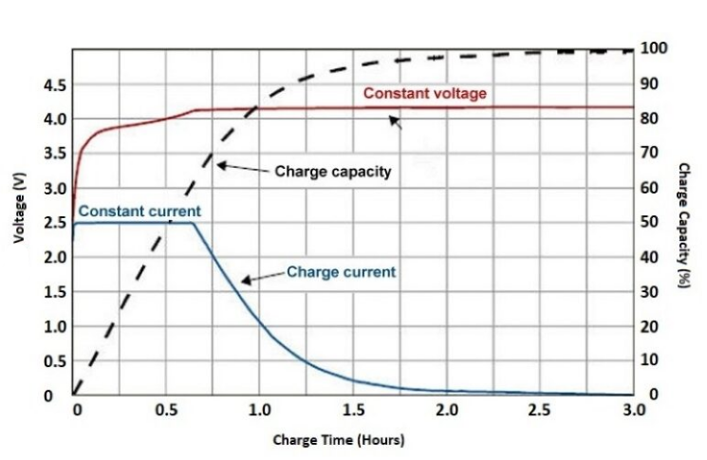
Figure 1.6 :- Charge curve of Lithium –Ion Battery

Slide 14
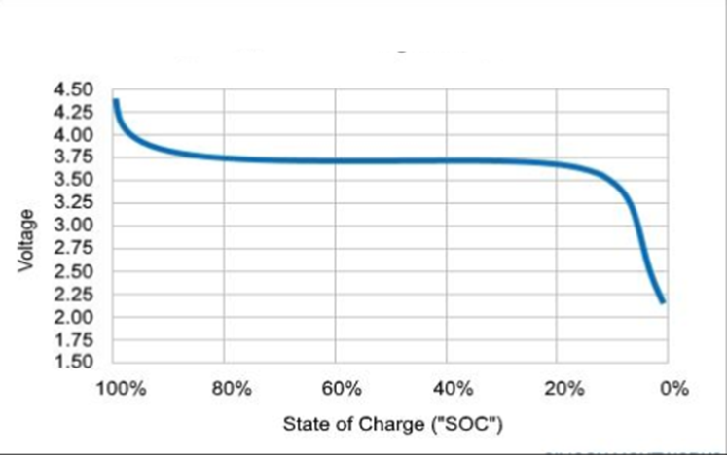
Figure :-Discharge curve of Lithium–Ion Battery

Slide 15
PROBLEM STATEMENT-
To observe the SOC and charging current of different batteries in series and parallel combination with different loads using Matlab Simulink and Simscape .
OBJECTIVE–
1. Identifying time duration while charging different batteries separately and in different combination.
2. Identifying variation in charging current characteristics of different batteries .
3. Design and develop the circuit for display of SOC and charging current for different varying loads through simulation.
4. Experimentation and validation of results.
Analysis of results.

Slide 16
RESULT & DISCUSSION:-
The simulation of Lead –Acid and Lithium –Ion is done separately and also their series and parallel combination i.e not only lead with lead and lithium with lithium ion is done but also intermixing of two different batteries is also done i.e lead with lithium ion with both series and parallel combinatiom is simulated and their results both through display and waveform characteristics is obtained which depicts their peculiar charging current characteristics specially when intermixing is done with two different batteries. Finally their separate tables are made showcasing the state of charge with time duration .
Lead acid battery charging:
. DC voltage sourcs:- 12 volt
. Lead acid nominal voltage:- 7.2 volt
. Rated capacity:- 95 Ah
. Initial state of charge:- 45%
. Battery response time:- 30 seconds

Slide 17
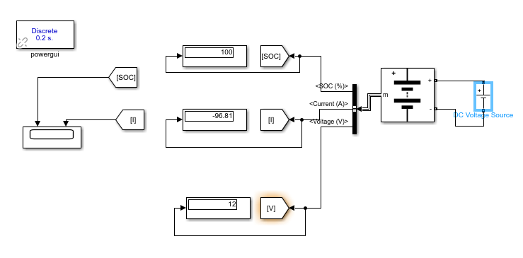
SERIES COMBINATION OF LEAD ACID BATTERIES CHARGING
CIRCUIT DIAGRAM OF LEAD-ACID BATTERY CHARGING FOR 425 SECONDS

Slide 18
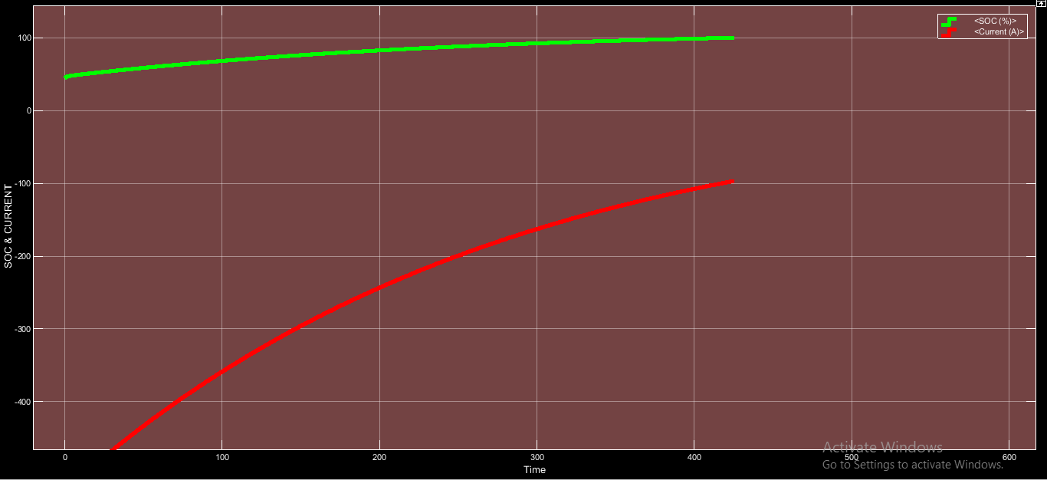
SOC & CURRENT WAVEFORM OF LEAD ACID BATTERY CHARGING FOR 425 SECONDS

Slide 19
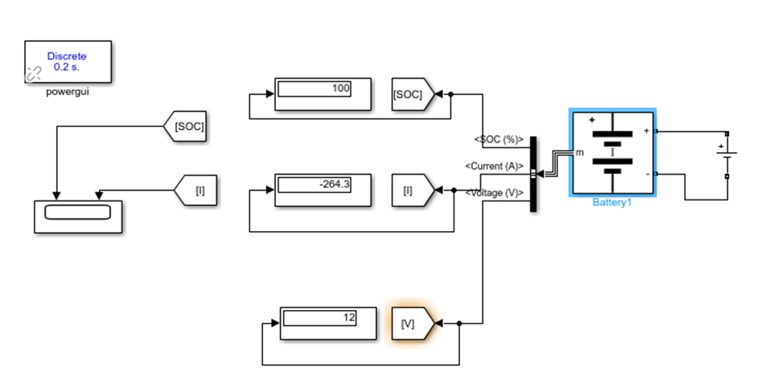
Lithium Ion battery charging:
. DC voltage sourcs:- 12 volt . Lead acid nominal voltage:- 7.2 volt
. Rated capacity:- 55 Ah . Initial state of charge:- 45% . Battery response time:- 30 seconds

Slide 20
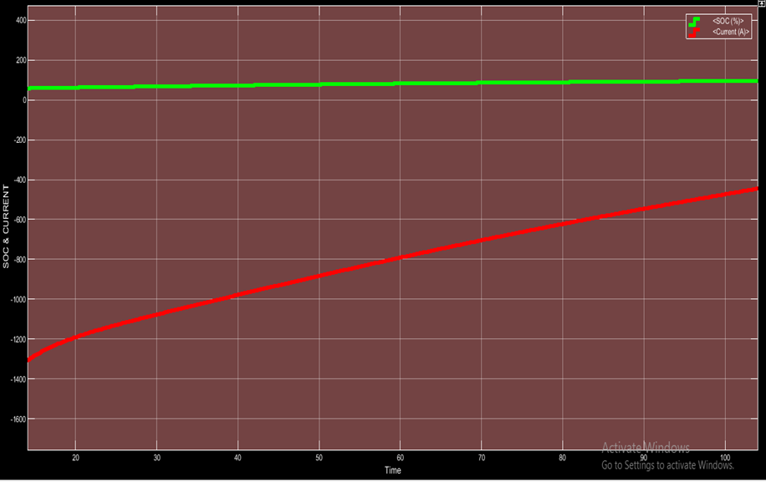
SOC & CURRENT WAVEFORM OF LITHIUM ION BATTERY CHARGING FOR 135 SECONDS IS CAPTURED AND DISPLAYED FOR BETTER OBSERVATION

Slide 21
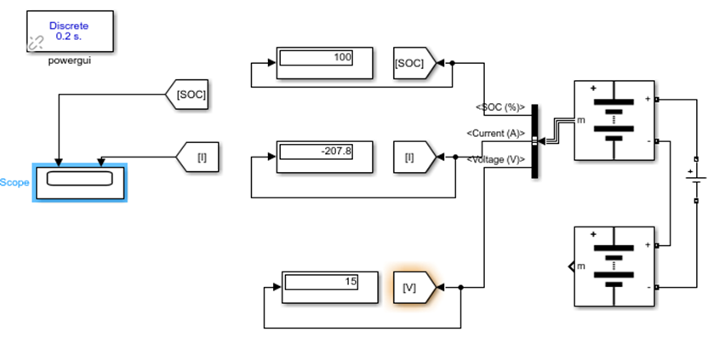
SERIES COMBINATION OF LEAD ACID BATTERIES CHARGING
. DC Voltage Source = 30 Volt . Lead acid nominal voltage:- 7.2 volt
. Rated capacity:- 55 Ah . Initial state of charge:- 45% . Battery response time:- 30 seconds
FIGURE :- CIRCUIT DIAGRAM OF LEAD-ACID & LEAD-ACID BATTERY SERIES CHARGING FOR 1 HOUR

Slide 22
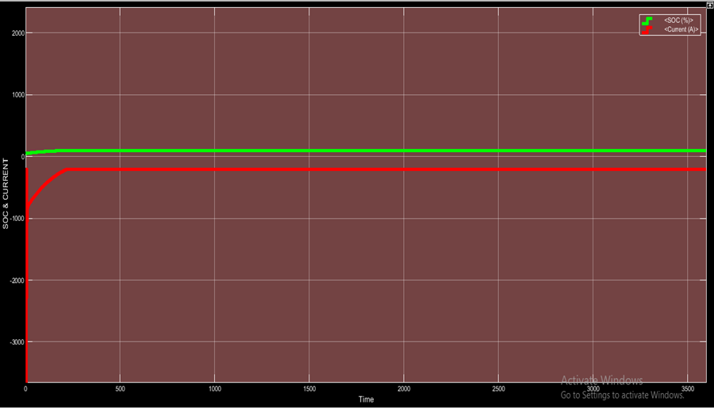
Figure:- SOC & CURRENT WAVEFORMM OF LEAD ACID & LEAD ACID BATTERY SERIES CHARGING

Slide 23
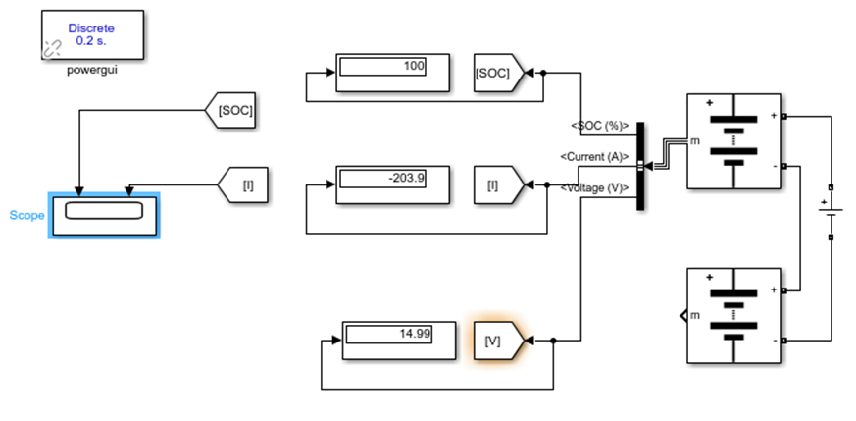
SERIES COMBINATION OF LITHIUM ION-LEAD ACID BATTERIES CHARGING
DC Voltage Source = 30 Volt . Lead acid and Lithium –Ion nominal voltage:- 7.2 volt
. Rated capacity:- 55 Ah . Initial state of charge:- 45% . Battery response time:- 30 seconds
CIRCUIT DIAGRAM OF LEAD ACID BATTERY CONNECTED IN SERIES WITH LITHIUM ION BATTERY FOR 1 HOUR

Slide 24
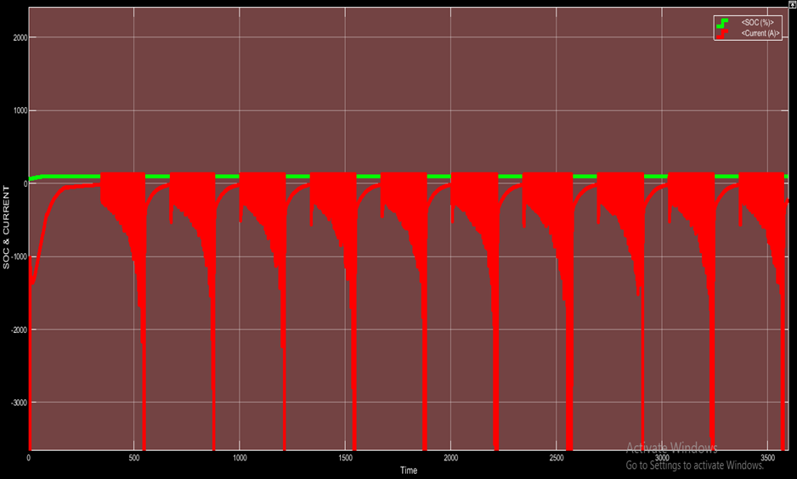
FIGURE :-SOC & CURRENT WAVEFORM OF LEAD ACID BATTERY CONNECTED SERIESWITHLITHIUM ION BATTERY FOR 1 HOUR

Slide 25
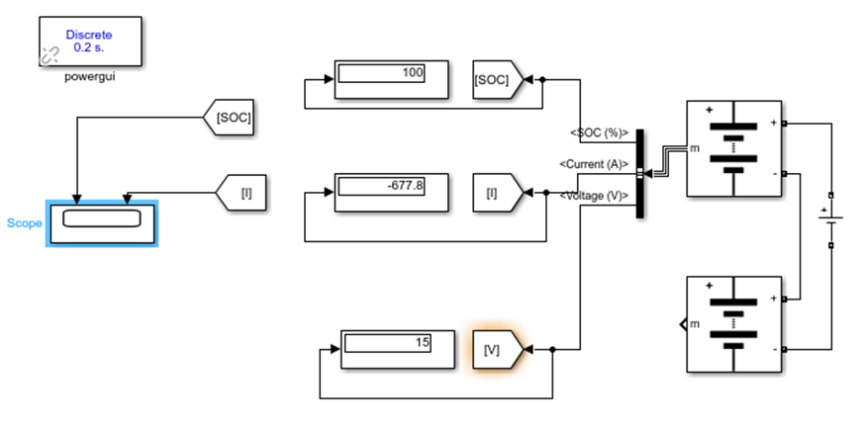
LITHIUM ION-LITHIUM ION SERIES CHARGING
DC Voltage Source = 30 Volt . Lithium –Ion nominal voltage:- 7.2 volt
. Rated capacity:- 55 Ah . Initial state of charge:- 45% . Battery response time:- 30 seconds
FIGURE :-CIRCUIT DIAGRAM OF LITHIUM ION BATTY CONNECTED IN SERIES WITH LITHIUM ION BATTERY FOR 1 HOUR

Slide 26
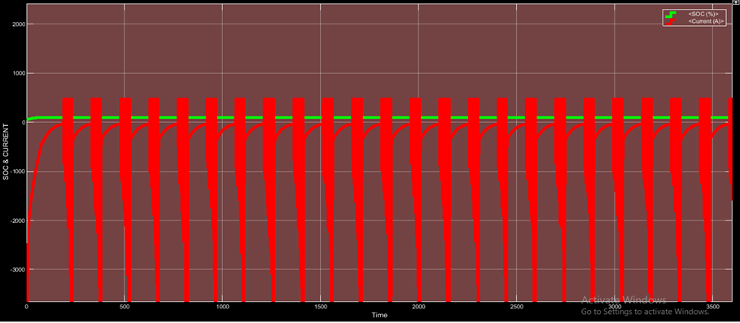
FIGURE:-SOC & CURRENT WAVEFORM OF LITHIUM ION BATTERY CONNECTED IN SERIES WITH LITHIUM ION BATTERY FOR 1 HOUR

Slide 27
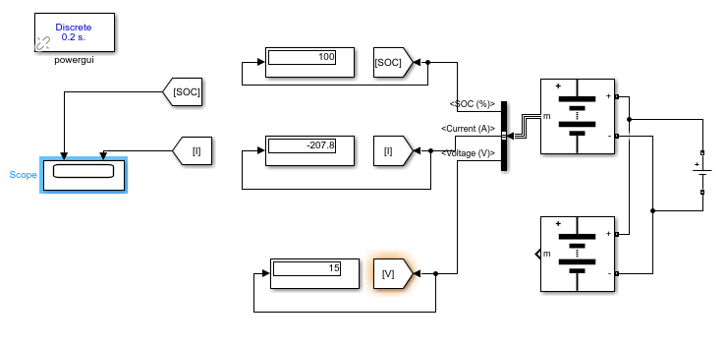
LEAD ACID-LEAD ACID BATTERY PARALLEL CHARGING:
DC Voltage Source = 15 Volt . Lithium –Ion nominal voltage:- 7.2 volt
. Rated capacity:- 55 Ah . Initial state of charge:- 45% . Battery response time:- 30 seconds
Figure:-CIRCUIT DIAGRAM OF BOTH LEAD ACID BATTERY FOR PARALLEL CHARGING FOR 1 HOUR

Slide 28
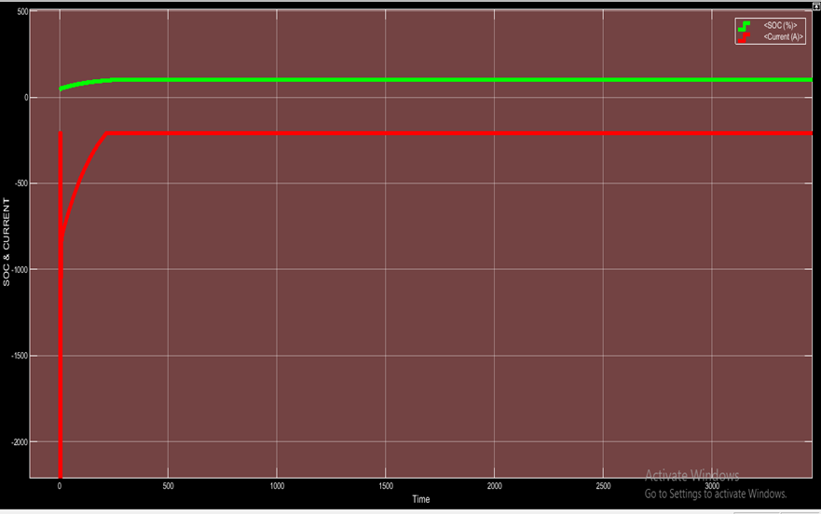
Figure :- SOC & CURRENT WAVEFORM OF BOTH LEAD ACID BATTERY CONNECTED IN PARALLEL FOR CHARGING FOR 1 HOUR

Slide 29
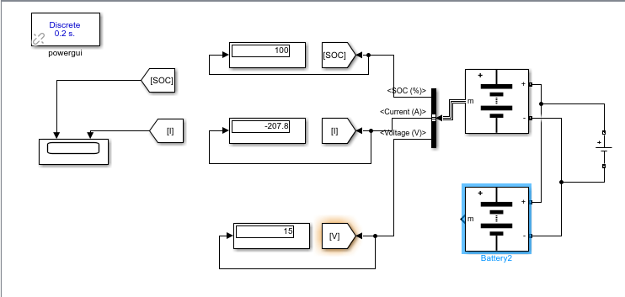
LEAD ACID-LITHIUM ION BATTERY PARALLEL CHARGING:
DC Voltage Source = 15 Volt . Lead Acid & Lithium –Ion nominal voltage:- 7.2 volt
. Rated capacity:- 55 Ah . Initial state of charge:- 45% . Battery response time:- 30 seconds
Figure :-SOC & CURRENT WAVEFORM OF LEAD ACID BATTERY & LITHIUM ION BATTERY FOR PARALLEL CHARGING FOR 1 HOUR

Slide 30
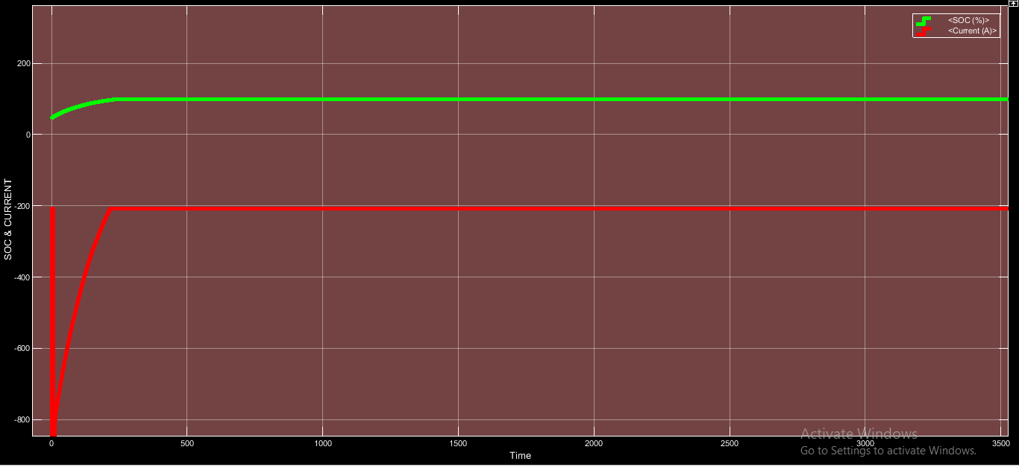
Figure :-SOC & CURRENT WAVEFORM OF LEAD ACID BATTERY & LITHIUM ION BATTERY FOR PARALLEL CHARGING FOR 1 HOUR

Slide 31
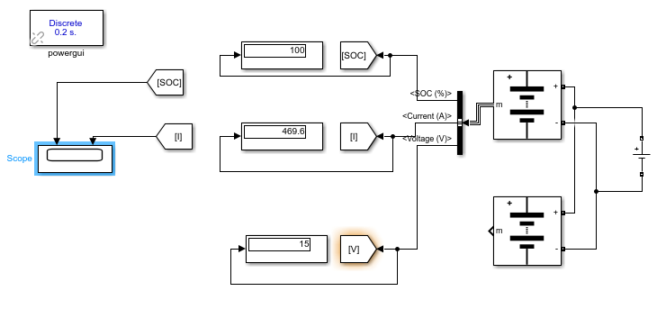
LITHIUM ION-LITHIUM ION BATTERY PARALLEL CHARGING:
SOC & CURRENT WAVEFORM OF LITHIUM ION BATTERY & LITHIUM ION BATTERY FOR PARALLEL CHARGING FOR 1 HOUR

Slide 32
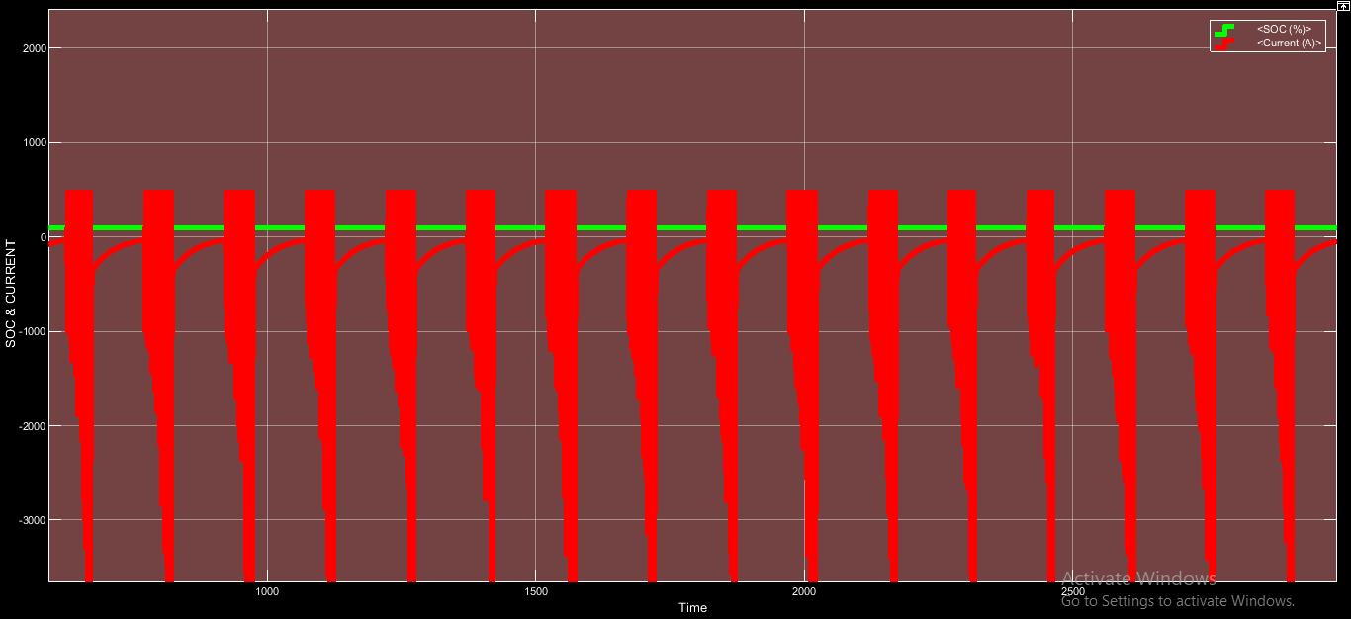
Figure :-SOC & CURRENT WAVEFORM OF LITHIUM ION BATTERY & LITHIUM ION BATTERY FOR PARALLEL CHARGING FOR 1 HOUR

Slide 33
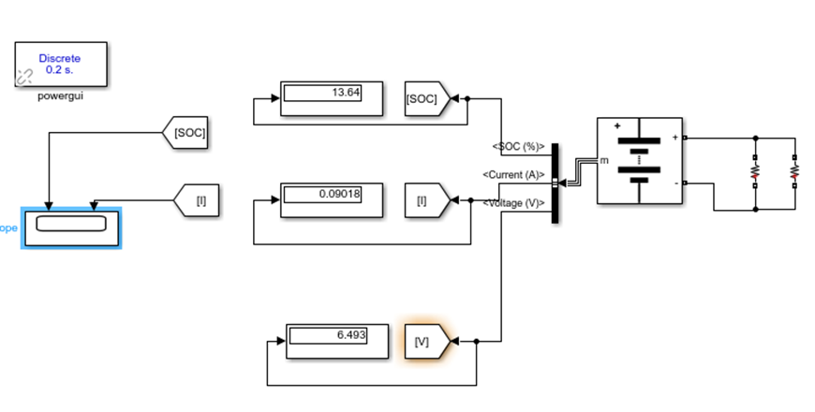
LEAD ACID BATTERY DISCHARGE:
Initially the battery charging is taken as 100% and nominal voltage of battery is taken as 7.2 volt .
Figure:- CIRCUIT DIAGRAM OF DISCHARGE OF LEAD ACID BATTERY WITH LOAD RESISTANCE 72 OHMS FOR 500 HOURS

Slide 34
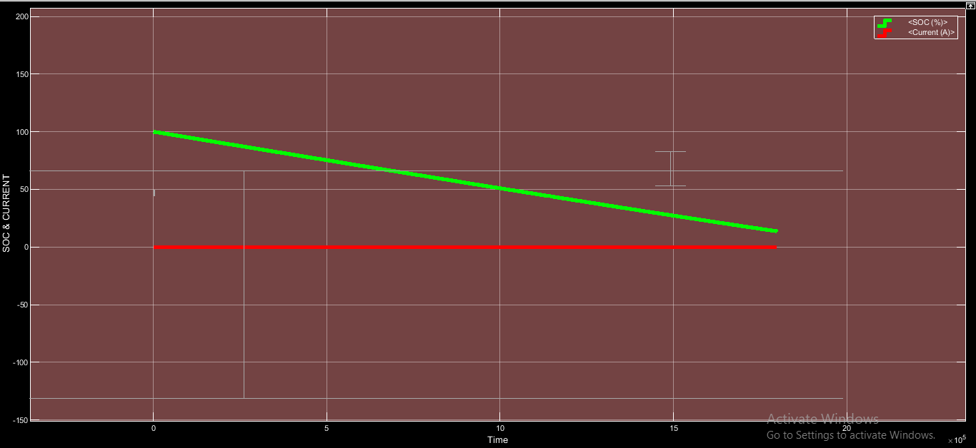
Figure :- SOC & CURRENT WAVEFORM OF LEAD ACID BATTERY DISCHARGE FOR 500 HOURS

Slide 35
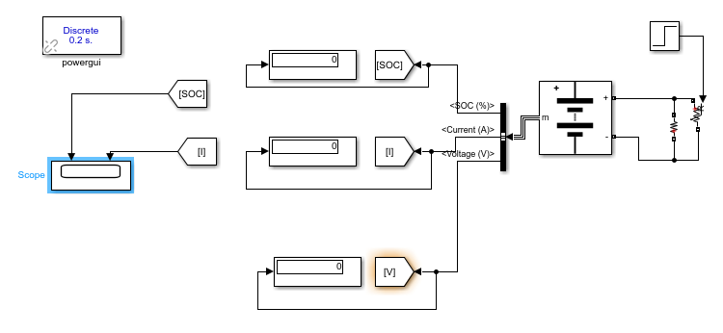
Figure :- CIRCUIT DIAGRAM OF DISCHARGE OF LEAD ACID BATTERY WITH LOAD AS STEP SIGNAL FOR 25 HOURS

Slide 36
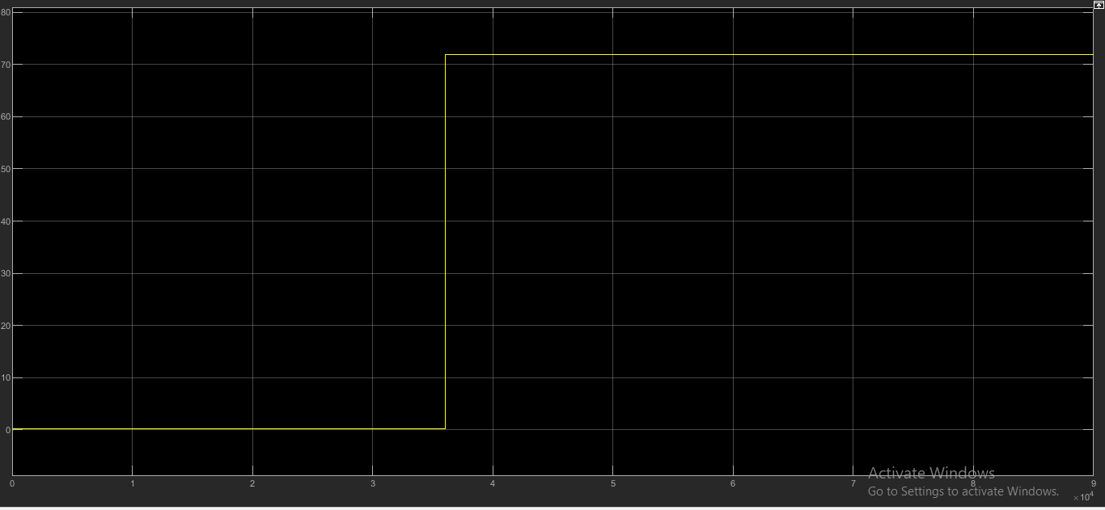
FIGURE SHOWING STEP SIGNAL

Slide 37
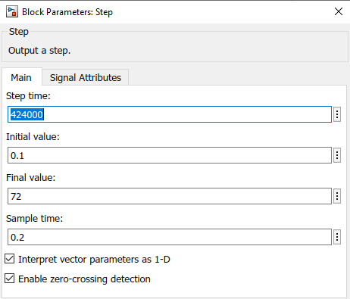
Figure :- IMAGE SHOWING DETAILS OF STEP SIGNAL

Slide 38
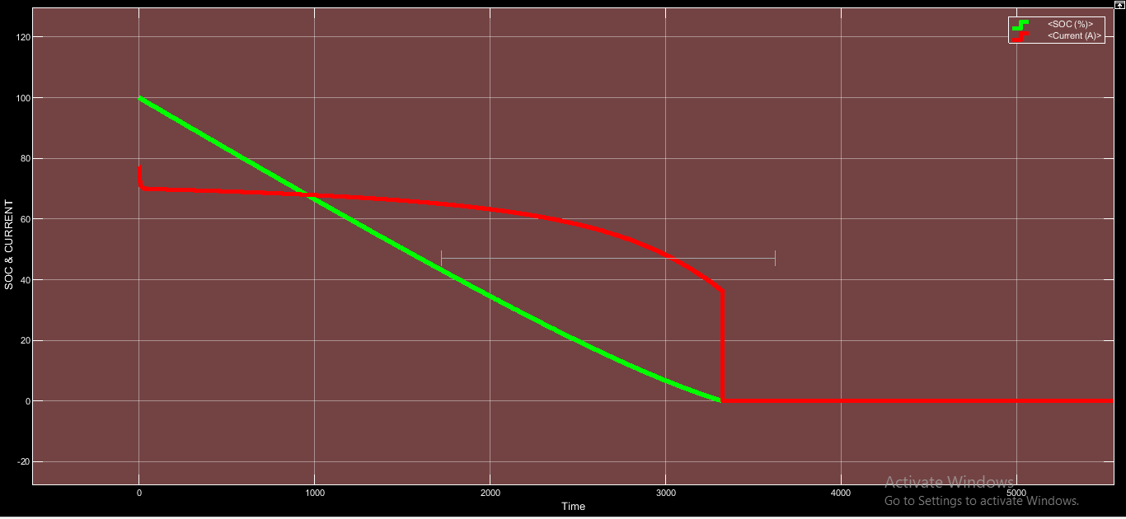
Figure :- SOC & CURRENT WAVEFORM OF DISCHARGE OF LEAD ACID BATTERY CONNECTED TO STEP SIGNAL FOR 25 HOURS

Slide 39
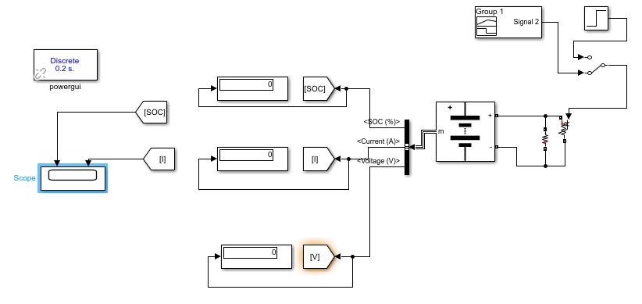
Figure - CIRCUIT DIAGRAM OF LEAD ACID BATTERY DISCHARGE CONNECTED TO LOAD OF STEP SIGNAL WITH RAMP START PROVIDED BY SIGNAL BUILDER FOR 250 HOURS

Slide 40
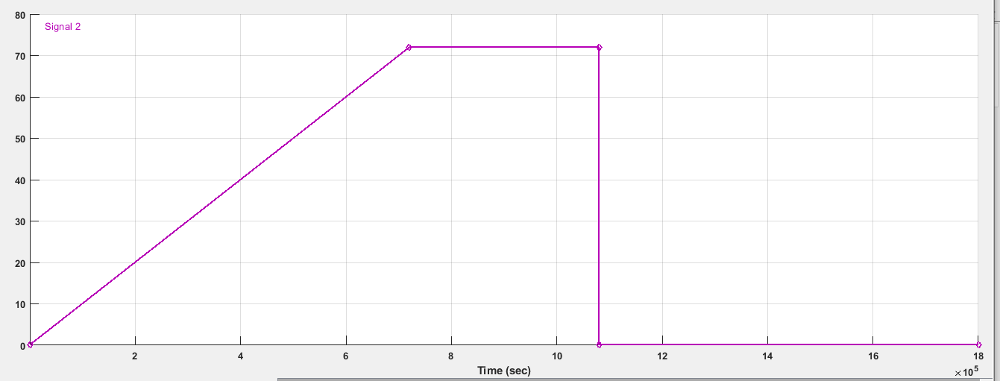
Figure:- IMAGE OF STEP SIGNAL WITH RAMP START DEVELOPED IN SIGNAL BUILDER

Slide 41
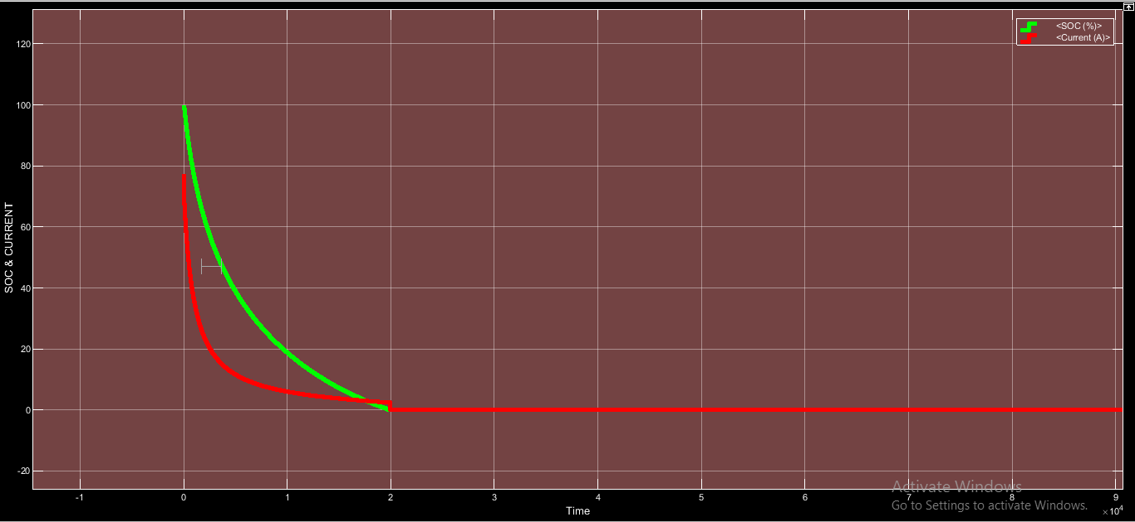
Figure:- SOC & CURRENT WAVEFORM OF LEAD ACID BATTERY DISCHARGE CONNECTED TO LOAD OF STEP SIGNAL WITH RAMP START FOR 250 HOURS

Slide 42
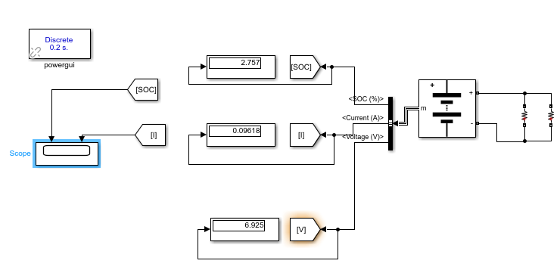
LITHIUM ION BATTERY DISCHARGE:
CIRCUIT DIAGRAM OF DISCHARGE OF LITHIUM ION BATTERY WITH LOAD RESISTANCE 72 OHMS FOR 500 HOURS

Slide 43
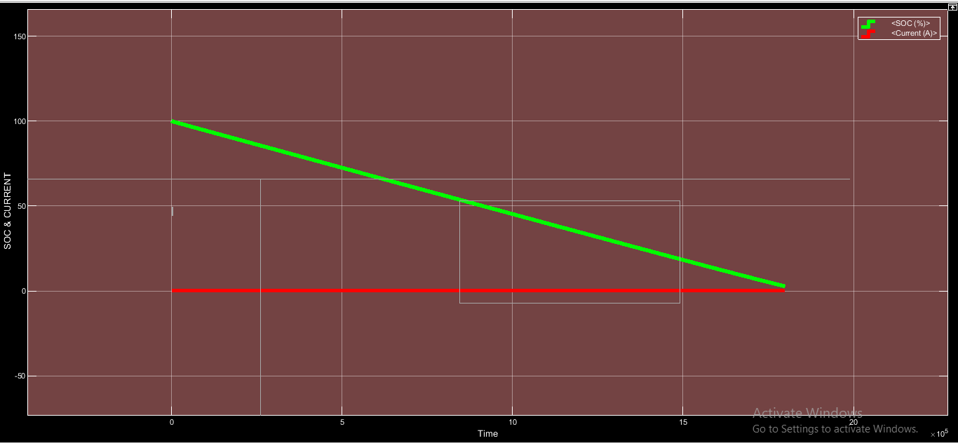
Figure :-- SOC & CURRENT WAVEFORM OF LITHIUM ION BATTERY DISCHARGE FOR 500 HOURS

Slide 44
Figure :- CIRCUIT DIAGRAM OF DISCHARGE OF LITHIUM ION BATTERY WITH LOAD AS STEP SIGNAL FOR 25 HOURS

Slide 45
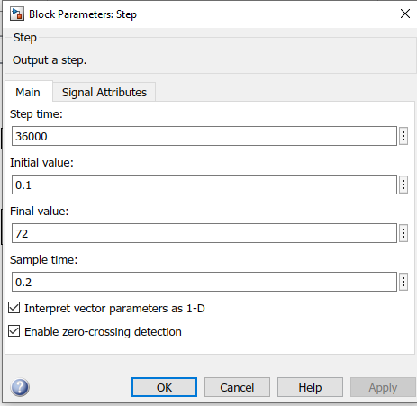
Figure :- IMAGE SHOWING DETAILS OF STEP SIGNAL

Slide 46
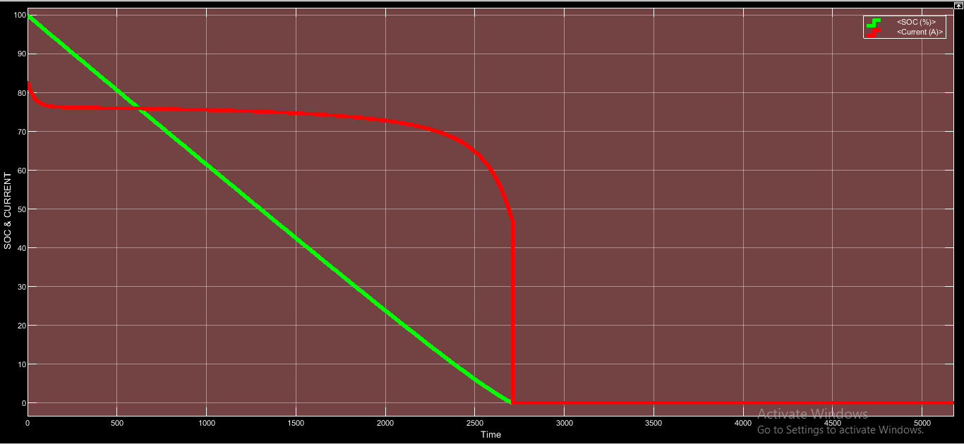
Figure :- SOC & CURRENT WAVEFORM OF DISCHARGE OF LITHIUM ION BATTERY CONNECTED TO STEP SIGNAL FOR 25 HOURS

Slide 47
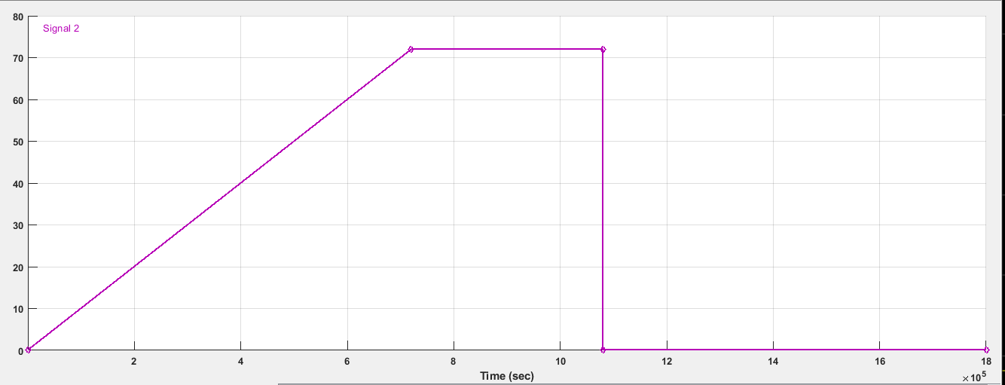
Figure :- IMAGE OF STEP SIGNAL WITH RAMP START DEVELOPED IN SIGNAL BUILDER

Slide 48
Figure :- CIRCUIT DIAGRAM OF DISCHARGE OF LITHIUM ION BATTERY WITH LOAD AS STEP SIGNAL WITH RAMP START FOR 20 HOURS

Slide 49
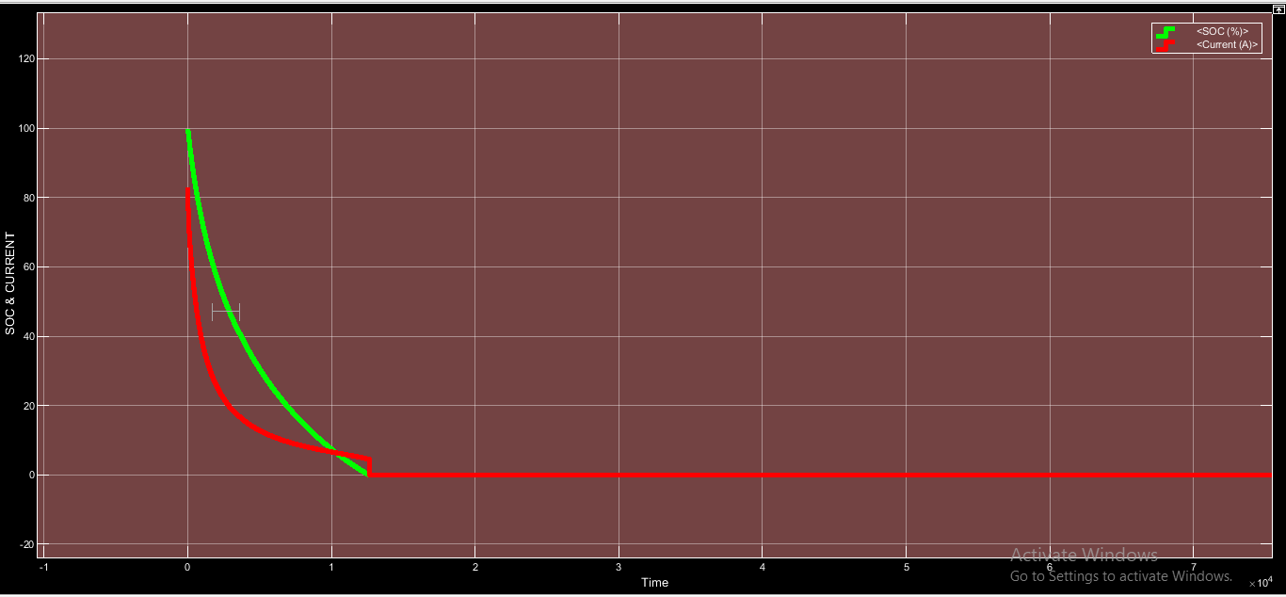
Figure:- SOC & CURRENT WAVEFORM OF DISCHARGE OF LITHIUM ION BATTERY CONNECTED TO LOAD AS STEP SIGNAL WITH RAMP START FOR 20 HOURS

Slide 50
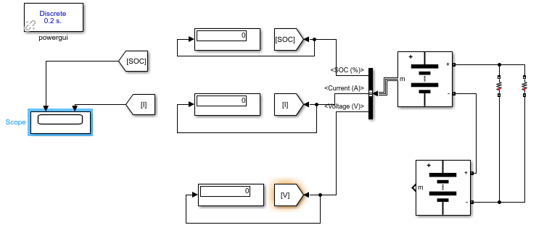
LEAD ACID-LEAD ACID SERIES BATTERY DISCHARGE:
Figure :- CIRCUIT DIAGRAM OF DISCHARGE OF LEAD ACID-LEAD ACID SERIES BATTERY WITH LOAD AS 72 OHM RESISTANCE FOR 500 HOURS

Slide 51
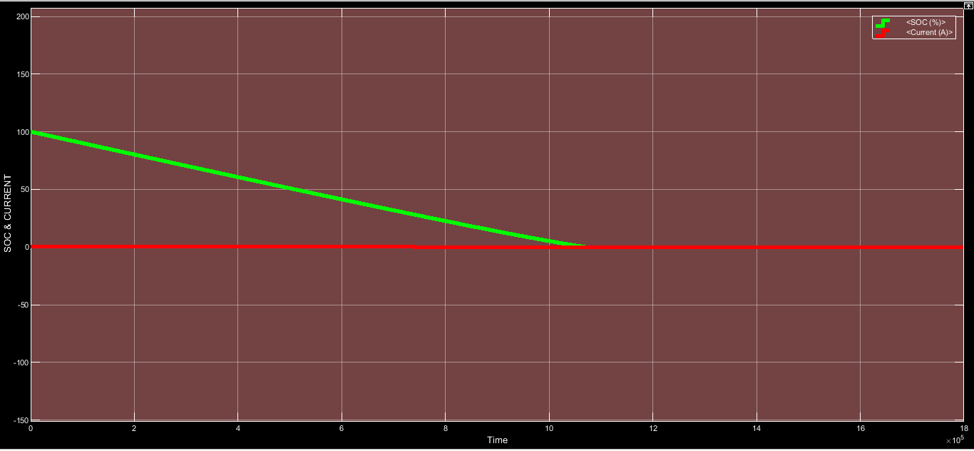
Figure:- SOC & CURRENT WAVEFORM OF DISCHARGE OF LEAD ACID-LEAD ACID SERIES BATTERY CONNECTED TO LOAD RESISTANCE OF 72 OHMS FOR 500 HOURS

Slide 52
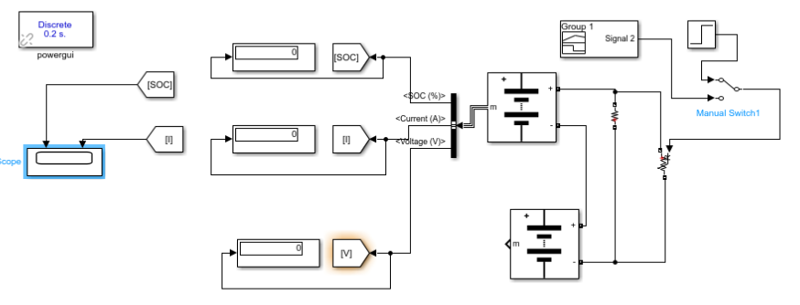
Figure :- CIRCUIT DIAGRAM OF DISCHARGE OF LEAD ACID-LEAD ACID SERIES BATTERY WITH LOAD AS STEP SIGNAL WITH RAMP START FOR 500 HOURS

Slide 53
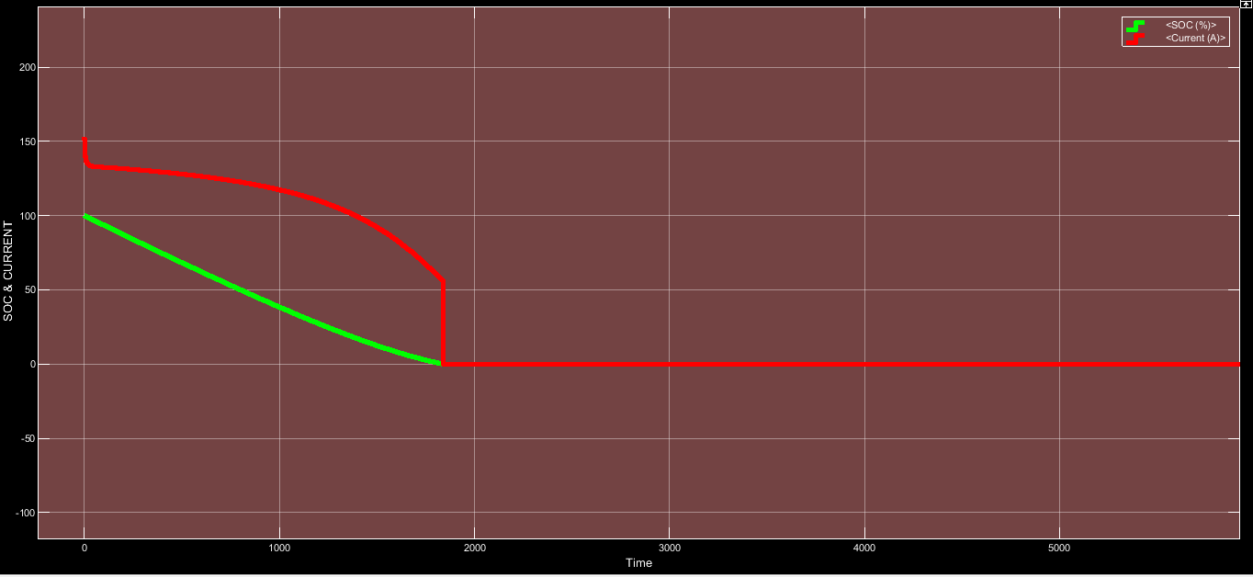
Figure:-SOC & CURRENT WAVEFORM OF OF DISCHARGE OF LEAD ACID-LEAD ACID SERIES BATTERY WITH LOAD AS STEP SIGNAL WITH RAMP START FOR 500 HOURS

Slide 54
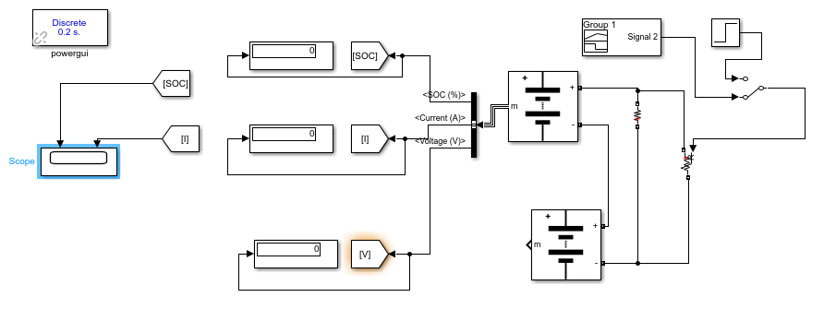
Figure:- CIRCUIT DIAGRAM OF DISCHARGE OF LEAD ACID-LEAD ACID SERIES BATTERY WITH LOAD AS STEP SIGNAL WITH RAMP START DEVELOPED BY SIGNAL BUILDER FOR 500 HOURS

Slide 55
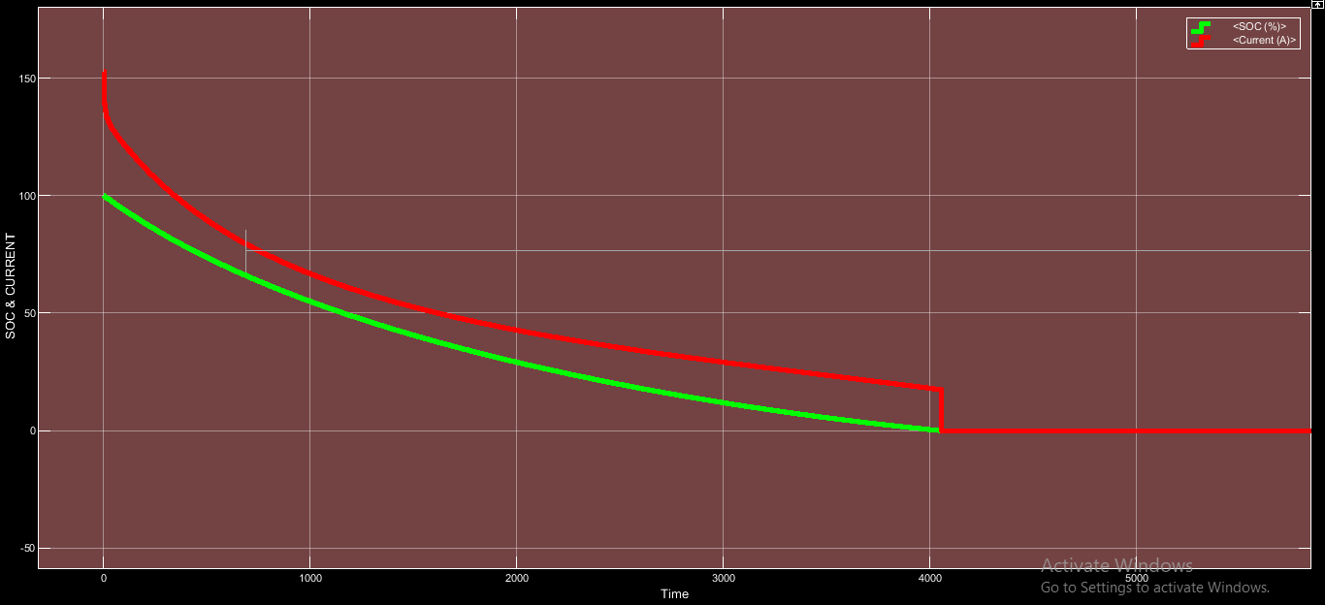
Figure :- SOC & CURRENT WAVEFORM OF DISCHARGE OF LEAD ACID-LEAD ACID SERIES BATTERY WITH LOAD AS STEP SIGNAL WITH RAMP START DEVELOPED BY SIGNAL BUILDER FOR 500 HOURS

Slide 56
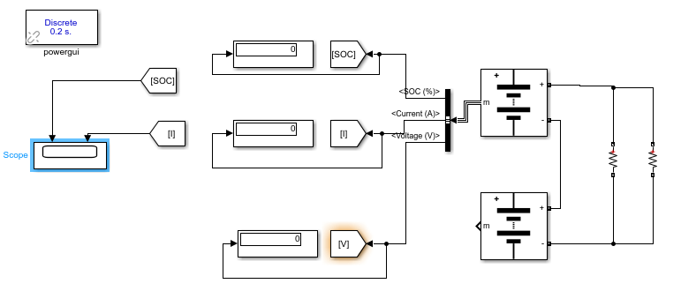
LEAD ACID-LITHIUM ION SERIES BATTERY DISCHARGE:
Figure :- CIRCUIT DIAGRAM OF DISCHARGE OF LEAD ACID-LITHIUM ION ACID SERIES BATTERY WITH LOAD RESISTANCE OF 72 OHMS FOR 500 HOURS

Slide 57
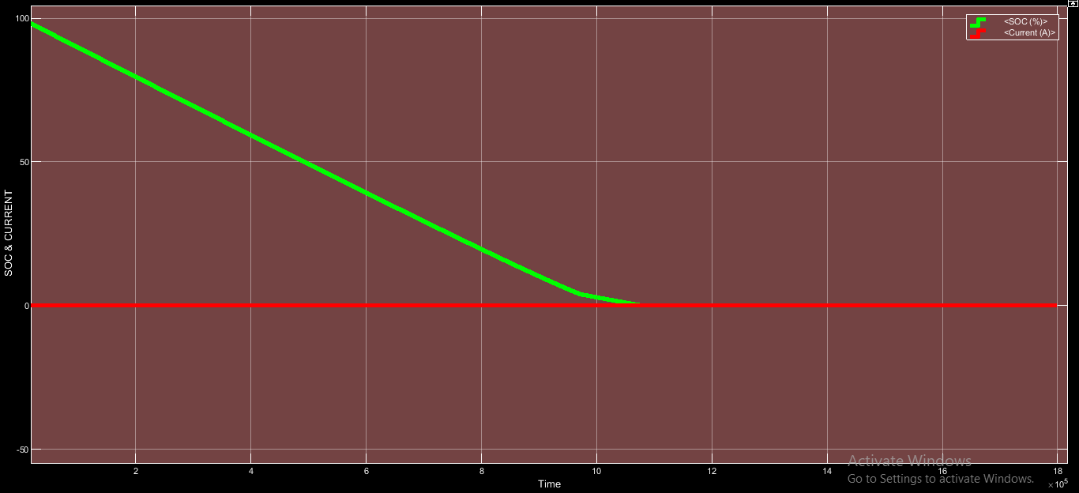
Figure :- WAVEFORM OF DISCHARGE OF LEAD ACID-LITHIUM ION ACID SERIES BATTERY WITH LOAD RESISTANCE OF 72 OHMS FOR 500 HOURS

Slide 58
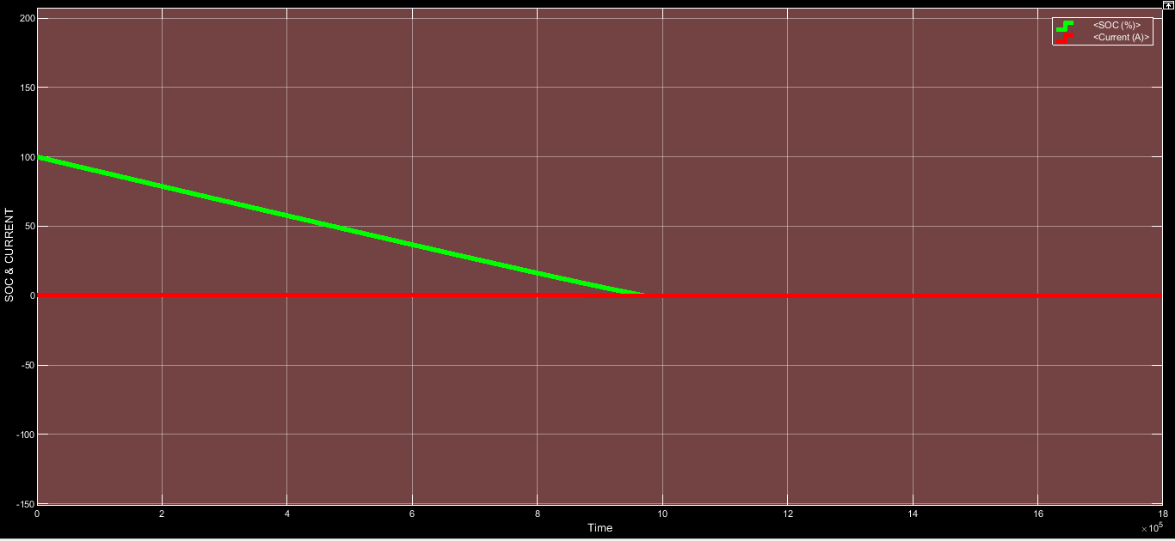
Figure :- SOC & CURRENT WAVEFORM OF DISCHARGE OF LEAD ACID-LITHIUM ION ACID SERIES BATTERY WITH LOAD AS STEP SIGNAL FOR 500 HOURS

Slide 59
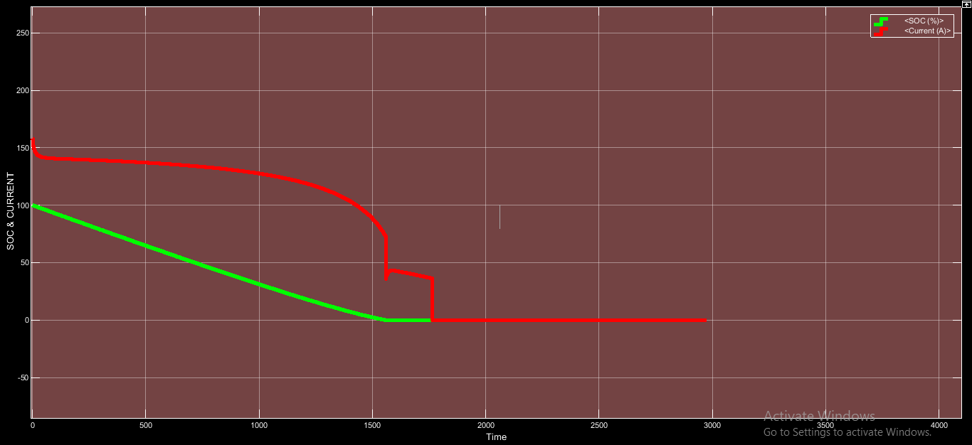
Figure :- SOC & CURRENT WAVEFORM OF DISCHARGE OF LEAD ACID-LITHIUM ION ACID SERIES BATTERY WITH LOAD AS STEP SIGNAL WITH RAMP START FOR 500 HOURS

Slide 60
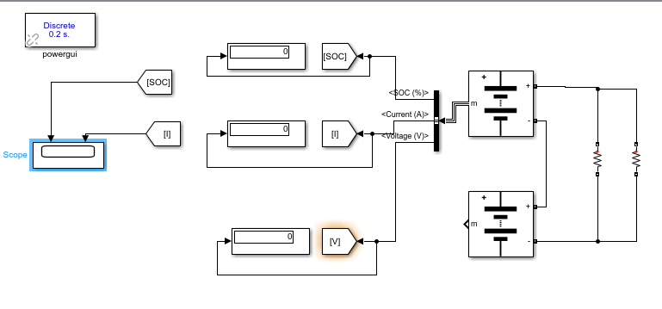
LITHIUM ION-LITHIUM ION SERIES BATTERY DISCHARGE:
Figure :- CIRCUIT DIAGRAM OF DISCHARGE OF LITHIUM ION-LITHIUM ION ACID SERIES BATTERY WITH LOAD RESISTANCE OF 72 OHMS FOR 500 HOURS

Slide 61
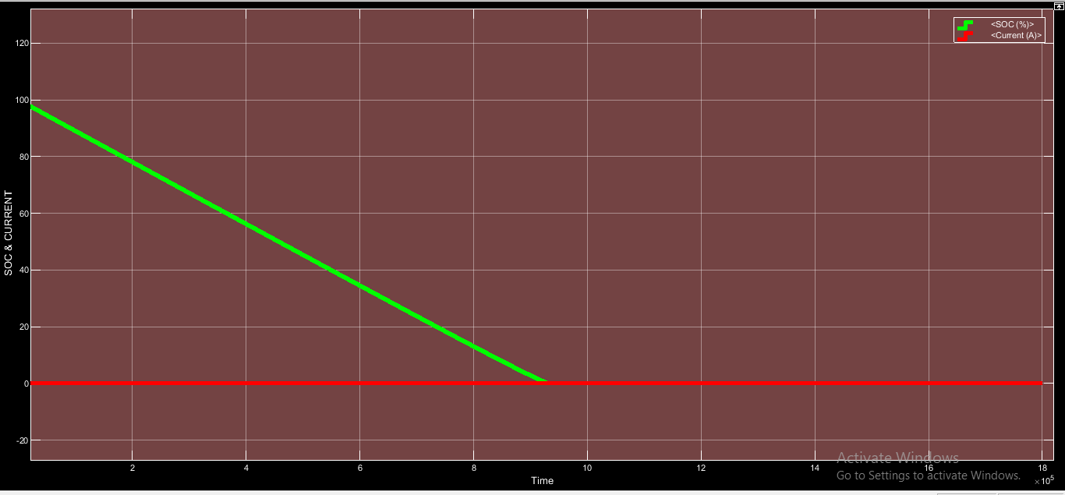
Figure :- SOC & CURRENT WAVEFORM OF DISCHARGE OF LITHIUM ION-LITHIUM ION ACID SERIES BATTERY WITH LOAD RESISTANCE OF 72 OHMS FOR 500 HOURS

Slide 62

Figure :- SOC & CURRENT WAVEFORM OF DISCHARGE OF LITHIUM ION-LITHIUM ION ACID SERIES BATTERY WITH LOAD AS STEP SIGNAL FOR 500 HOURS

Slide 63
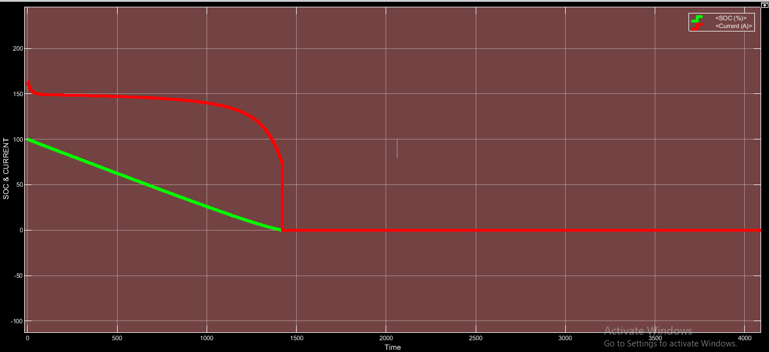
Figure :- SOC & CURRENT WAVEFORM OF DISCHARGE OF LITHIUM ION-LITHIUM ION ACID SERIES BATTERY WITH LOAD AS STEP SIGNAL WITH RAMP START FOR 500 HOURS

Slide 64
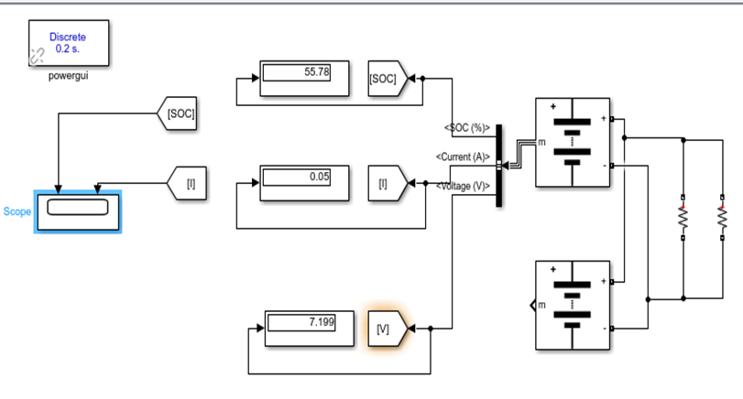
LEAD ACID BATTERY PARALLEL DISCHARGE:
Figure :- CIRCUIT DIAGRAM OF DISCHARGE OF PARALLEL CONNECTED LEAD ACID-LEAD ACID ACID BATTERY WITH LOAD RESISTANCE OF 72 OHMS FOR 500 HOURS

Slide 65
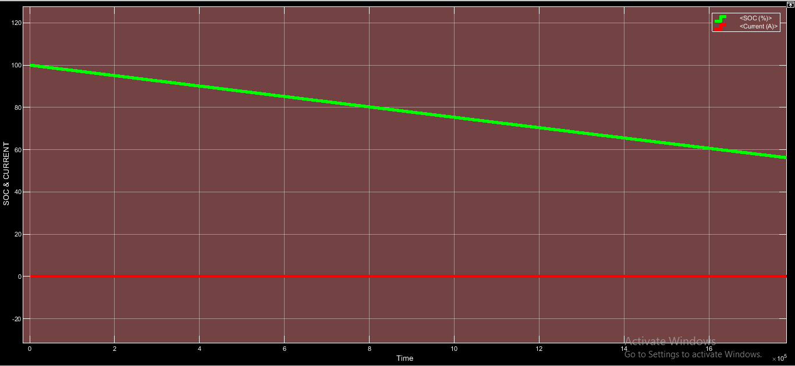
Figure :- SOC & CURRENT WAVEFORM OF DISCHARGE OF PARALLEL CONNECTED LEAD ACID-LEAD ACID ACID BATTERY WITH LOAD RESISTANCE OF 72 OHMS FOR 500 HOURS

Slide 66
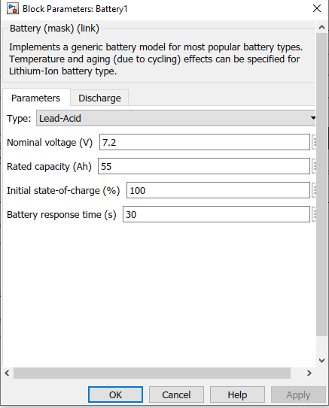
DETAIL OF LEAD ACID BATTERY

Slide 67
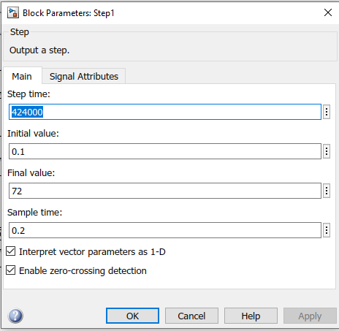
IMAGE SHOWING DETAIL OF STEP SIGNAL

Slide 68

CIRCUIT DIAGRAM OF DISCHARGE OF PARALLEL CONNECTED LEAD ACID-LEAD ACID ACID BATTERY WITH LOAD AS STEP SIGNAL FOR 500 HOURS

Slide 69

Figure :- SOC & CURRENT WAVEFORM OF DISCHARGE OF PARALLEL CONNECTED LEAD ACID-LEAD ACID ACID BATTERY WITH LOAD AS STEP SIGNAL FOR 500 HOURS

Slide 70

Figure :- CIRCUIT DIAGRAM OF DISCHARGE OF PARALLEL CONNECTED LEAD ACID- LEAD ACID BATTERY WITH LOAD AS STEP SIGNAL WITH RAMP START DEVELOPED BY SIGNAL BUILDER FOR 500 HOURS

Slide 71

Figure :- SOC & CURRENT WAVEFORM OF DISCHARGE OF PARALLEL CONNECTED LEAD ACID-LEAD ACID BATTERY WITH LOAD AS STEP SIGNAL WITH RAMP START DEVELOPED BY SIGNAL BUILDER FOR 500 HOURS

Slide 72

LEAD ACID-LITHIUM ION BATTERY PARALLEL DISCHARGE:
CIRCUIT DIAGRAM OF DISCHARGE OF PARALLEL CONNECTED LEAD ACID-LITHIUM ION BATTERY WITH LOAD RESISTANCE 72 OHMS FOR 470 HOURS

Slide 73

Figure :- SOC & CURRENT WAVEFORM OF DISCHARGE OF PARALLEL CONNECTED LEAD ACID-LITHIUM ION BATTERY WITH LOAD RESISTANCE 72 OHMS FOR 470 HOURS

Slide 74

Figure:- CIRCUIT DIAGRAM OF DISCHARGE OF PARALLEL CONNECTED LEAD ACID-LITHIUM ION BATTERY WITH LOAD AS STEP SIGNAL FOR 140 HOURS

Slide 75

Figure :- SOC & CURRENT WAVEFORM OF DISCHARGE OF PARALLEL CONNECTED LEAD ACID-LITHIUM ION BATTERY WITH LOAD AS STEP SIGNAL FOR 140 HOURS

Slide 76

Figure:- CIRCUIT DIAGRAM OF DISCHARGE OF PARALLEL CONNECTED LEAD ACID-LITHIUM ION BATTERY WITH LOAD AS STEP SIGNAL WITH RAMP START FOR 200 HOURS

Slide 77

Figure:- SOC & CURRENT WAVEFORM OF DISCHARGE OF PARALLEL CONNECTED LEAD ACID-LITHIUM ION BATTERY WITH LOAD AS STEP SIGNAL WITH RAMP START FOR 200 HOURS

Slide 78

LITHIUM ION-LITHIUM ION BATTERY PARALLEL DISCHARGE
CIRCUIT DIAGRAM OF DISCHARGE OF PARALLEL CONNECTED LITHIUM ION-LITHIUM ION BATTERY WITH LOAD AS 72 OHMS FOR 500 HOURS

Slide 79

Figure:- SOC & CURRENT WAVEFORM OF DISCHARGE OF PARALLEL CONNECTED LITHIUM ION-LITHIUM ION BATTERY WITH LOAD AS 72 OHMS FOR 500 HOURS

Slide 80

Figure :- CIRCUIT DIAGRAM OF DISCHARGE OF PARALLEL CONNECTED LITHIUM ION-LITHIUM ION BATTERY WITH LOAD AS STEP SIGNAL FOR 6 HOURS

Slide 81

Figure :- SOC & CURRENT WAVEFORM OF DISCHARGE OF PARALLEL CONNECTED LITHIUM ION-LITHIUM ION BATTERY WITH LOAD AS STEP SIGNAL FOR 6 HOURS

Slide 82

Figure:- CIRCUIT DIAGRAM OF DISCHARGE OF PARALLEL CONNECTED LITHIUM ION-LITHIUM ION BATTERY WITH LOAD AS STEP SIGNAL WITH RAMP START FOR 80 HOURS

Slide 83

Figure:- SOC & CURRENT WAVEFORM OF DISCHARGE OF PARALLEL CONNECTED LITHIUM ION-LITHIUM ION BATTERY WITH LOAD AS STEP SIGNAL WITH RAMP START FOR 80 HOURS

Slide 84

PV ARRAY IS CONNECTED TO LEAD ACID OR LITHIUM BATTERY WITH A BUCK CONVERTER WHICH IS FURTHER CONNECTED TO INVERTER WHICH IN TURN CONNECTED TO RECTIFIER & BOOST CONVERTER TO A LEAD ACID OR LITHIUM ION BATTERY
PV-ARRAY DETAILS

Slide 85


Slide 86


Slide 87

Figure:- MATLAB FUNCTION FOR DUTY CYCLE

Slide 88

Figure:- CIRCUIT DIAGRAM OF PV ARRAY CONNECTED TO LEAD ACID BATTERY WITH A BUCK CONVERTER WHICH IS FURTHER CONNECTED TO INVERTER WHICH IN TURN CONNECTED TO RECTIFIER & BOOST CONVERTER TO A LEAD ACID BATTERY

Slide 89

Figure:- DETAIL OF LEAD ACID BATTERY CONNECTED TO PV-ARRAY THROUGH A BUCK CONVERTER

Slide 90

Figure:- SOC , CURRENT & VOLTAGE CHARACTERISTICS OF LEAD ACID BATTERY CONNECTED TO PV-ARRAY THROUGH A BUCK CONVERTER

Slide 91

Figure:- DETAIL OF LEAD ACID BATTERY CONNECTED TO OUTPUT AS LOAD

Slide 92

Figure :- SOC , CURRENT & VOLTAGE CHARACTERISTICS OF LEAD ACID BATTERY CONNECTED TO OUTPUT AS LOAD

Slide 93

Figure:- CIRCUIT DIAGRAM OF PV ARRAY CONNECTED TO LEAD ACID BATTERY WITH A BUCK CONVERTER WHICH IS FURTHER CONNECTED TO INVERTER WHICH IN TURN CONNECTED TO RECTIFIER & BOOST CONVERTER TO A LITHIUM ION BATTERY

Slide 94

Figure:- DETAIL OF LEAD ACID BATTERY CONNECTED TO PV-ARRAY THROUGH A BUCK CONVERTER

Slide 95

Figure:- SOC , CURRENT & VOLTAGE CHARACTERISTICS OF LEAD ACID BATTERY CONNECTED TO PV-ARRAY THROUGH A BUCK CONVERTER

Slide 96

Figure:- DETAIL OF LITHIUM ION BATTERY CONNECTED TO OUTPUT AS LOAD

Slide 97

Figure:- SOC , CURRENT & VOLTAGE CHARACTERISTICS OF LITHIUM ION BATTERY CONNECTED TO OUTPUT AS LOAD

Slide 98

PV ARRAY CONNECTED TO LITHIUM ION BATTERY WITH A BUCK CONVERTER WHICH IS FURTHER CONNECTED TO INVERTER WHICH IN TURN CONNECTED TO RECTIFIER & BOOST CONVERTER TO A LITHIUM ION BATTERY

Slide 99

Figure:- DETAIL OF LITHIUM ION BATTERY CONNECTED TO CONNECTED TO PV-ARRAY THROUGH A BUCK CONVERTER

Slide 100

Figure:- SOC , CURRENT & VOLTAGE CHARACTERISTICS OF LITHIUM ION BATTERY CONNECTED TO PV-ARRAY THROUGH A BUCK CONVERTER

Slide 101

Figure:- DETAIL OF LITHIUM ION BATTERY CONNECTED TO CONNECTED TO OUTPUT AS LOAD

Slide 102

Figure:- SOC , CURRENT & VOLTAGE CHARACTERISTICS OF LITHIUM ION BATTERY CONNECTED TO OUTPUT AS LOAD

Slide 103

Figure:- CIRCUIT DIAGRAM OF PV ARRAY CONNECTED TO LITHIUM ION BATTERY WITH A BUCK CONVERTER WHICH IS FURTHER CONNECTED TO INVERTER WHICH IN TURN CONNECTED TO RECTIFIER & BOOST CONVERTER TO A LEAD ACID BATTERY

Slide 104

Figure:- DETAIL OF LITHIUM ION BATTERY CONNECTED TO CONNECTED TO PV-ARRAY THROUGH A BUCK CONVERTER

Slide 105

Figure:- SOC , CURRENT & VOLTAGE CHARACTERISTICS OF LITHIUM ION BATTERY CONNECTED TO PV-ARRAY THROUGH A BUCK CONVERTER

Slide 106

Figure:- DETAIL OF LEAD ACID BATTERY CONNECTED TO CONNECTED TO OUTPUT AS LOAD

Slide 107

Figure:- SOC , CURRENT & VOLTAGE CHARACTERISTICS OF LEAD ACID BATTERY CONNECTED TO OUTPUT AS LOAD

Slide 108
ANALYSIS OF LEAD ACID BATTERY CHARGING :- Initially the SOC & nominal voltage of Lead Acid battery taken as 45% and 7.2 volt . The SOC reaches to 100% and charging current becomes -96.81 mille Ampere within a period of 425 seconds .The charging current was more initially and reduced by time i.e with 24 volt DC source for charging lead acid battery of initial voltage of 7.2 volt , the charging current reduces exponentially .
ANALYSIS OF LITHIUM ION BATTERY CHARGING :- Initially the SOC & nominal voltage of Lithium Ion battery taken as 45% and 7.2 volt . The SOC reaches to 100% and charging current becomes -264.3 mille Ampere within a period of 425 seconds .The charging current was more initially and reduced by time i.e. with 24 volt DC source for charging lead acid battery of initial voltage of 7.2 volt , the charging current reduces somewhat linearly
ANALYSIS OF LEAD ACID –LEAD ACID SERIES BATTERY CHARGING: - Initially the SOC & nominal voltage of both Lead Acid batteries taken as 45% and 7.2 volt. The SOC reaches to 100% and charging current becomes -207.8 mille Ampere within a period of 1 hour as observed. .The charging current was more initially and reduced to constant i.e. with 30 volt DC source for charging lead acid battery of initial voltage of 7.2 volt , the charging current becomes constant.
ANALYSIS OF LEAD ACID –LITHIUM ION SERIES BATTERY CHARGING: - Initially the SOC & nominal voltage of Lead Acid & lithium ion battery taken as 45% and 7.2 volt . The SOC reaches to 100% and charging current becomes -203.9 mille Ampere within a period of 1 hour as observed . The charging current was more initially and reduced to constant i.e with 30 volt DC source for charging lead acid battery of initial voltage of 7.2 volt , the charging current initially increases & in a short time reduces and then after a small interval of regular 500 seconds , it further increases and then reduces again and this continues .

Slide 109
ANALYSIS OF LITHIUM ION –LITHIUM ION SERIES BATTERY CHARGING: - Initially the SOC & nominal voltage of both lithium ion batteries taken as 45% and 7.2 volt . The SOC reaches to 100% and charging current becomes -677.8 mille Ampere within a period of 1 hour as observed. The charging current was more initially and reduced to constant i.e with 30 volt DC source for charging lead acid battery of initial voltage of 7.2 volt , the charging current initially increases & in a short time reduces and then after a small interval of regular 200 seconds , it further increases and then reduces again and this continues .
ANALYSIS OF LEAD ACID –LEAD ACID PARALLEL BATTERY CHARGING:-
Initially the SOC & nominal voltage of both lead acid & lead acid battery taken as 45% and 7.2 volt. The SOC reaches to 100% and charging current becomes -207.8 mille Ampere within a period of 1 hour as observed. The charging current was more initially and reduced to constant i.e with 15 volt DC source for charging lead acid battery of initial voltage of 7.2 volt, the charging current initially increases & then reduces and this reduced current maintains constant throughout.
ANALYSIS OF LEAD ACID –LITHIUM ION PARALLEL BATTERY CHARGING :-
Initially the SOC & nominal voltage of both lead acid & lead acid battery taken as 45% and 7.2 volt. The SOC reaches to 100% and charging current becomes -207.8 mille Ampere within a period of 1 hour as observed. The charging current was more initially and reduced to constant i.e with 15 volt DC source for charging lead acid battery of initial voltage of 7.2 volt, the charging current initially increases & then reduces and this reduced current maintains constant throughout i.e the behavior is same as for lead acid-lead acid parallel battery charging .
ANALYSIS OF LITHIUM ION –LITHIUM ION PARALLEL BATTERY CHARGING:-
Initially the SOC & nominal voltage of both lead acid & lead acid battery taken as 45% and 7.2 volt. The SOC reaches to 100% and charging current becomes 469.6 mille Ampere within a period of 1 hour as observed i.e with 15 volt DC source for charging lead acid battery of initial voltage of 7.2 volt, the charging current initially very low & then reduces and this reduced current maintains constant throughout .

Slide 110
ANALYSIS OF LEAD ACID DISCHARGE:-For a period of 500 hour, the lead acid discharges from 100% to 13.64% and low discharge current develops and voltage reduces to 6.49 volt from 7.2 volt when 72 ohms resistance is connected at load & with step load, the current reduces in step and the for step signal with ramp start load , the current purely reduces exponentially and then becomes constant .
ANALYSIS OF LITHIUM ION DISCHARGE:-
For a period of 500 hour, the lead acid discharges from 100% to 2.757% and low discharge current develops and voltage reduces to 6.925 volt when 72 ohms resistance is connected at load & with step load, the current reduces in step with little curvature and finally becomes constant and the for step signal with ramp start load , the current purely reduces exponentially and then becomes constant .
ANALYSIS OF LEAD ACID-LEAD ACID SERIES DISCHARGE:-
The SOC reduces from 100% to 0% within a period of 300 hours & current almost remains constant for 72 ohms resistance at load. For step , the current reduces in a step format and finally becomes constant & SOC reduces to 0% in nearly 1800 seconds . For step with ramp start, the SOC reduces to 0 % in 4000 seconds & current droops exponentially with a step end and finally becomes constant .
ANALYSIS OF LEAD ACID-LITHIUM ION SERIES DISCHARGE:-
The SOC reduces from 100% to 0% within a period of 300 hours & current remains constant throughput for 72 ohms resistance at load .For step , the SOC reduces to 0% in 250 hours & current constant throughput . For step, the SOC reduces to 0% in 250 hours and current constant throughput .For step with ramp start, the SOC reduces to 0 % in 1200 seconds & current reduces to nearly zero in a step format with a curvature in 1750 seconds .

Slide 111
ANALYSIS OF LITHIUM ION-LITHIUM ION SERIES DISCHARGE:-
The SOC reduces from 100% to 0% within a period of 250 hours & current remains low constant throughput for 72 ohms resistance at load .For step , the SOC reduces to 0% in 250 hours & current constant throughput . For step, the SOC reduces to 0% in 250 hours and current remains low throughput .For step with ramp start , the SOC reduces to 0 % in 1400 seconds & current reduces to nearly zero , becomes constant at it , in a step format with a curvature in 1400 seconds .
ANALYSIS OF LEAD ACID –LEAD ACID PARALLEL DISCHARGE :-
The SOC reduces 58% in 500 hours and current remains low constant throughput for 72 ohms resistance at load .For step load , the SOC reduces to 0 in 170 hours & reduces in a step format to a low constant current . For step load with ramp start, the SOC reduces exponentially to zero in 110 hours and current remains constant low.
ANALYSIS OF LEAD ACID –LITHIUM ION PARALLEL DISCHARGE:-
The SOC reduces to 3.413% in 470 hours and current remains low constant throughput for 72 ohms resistance at load .For step load , the SOC reduces to 0 & current first increases & then continuously decreases in step format to low current in 165 hours . For step with ramp start load also, the same is observed.
ANALYSIS OF LITHIUM ION-LITHIUM ION PARALLEL DISCHARGE:-
The SOC reduces to 50.72% in 500 hours and current remains low constant throughput for 72 ohms resistance at load .For step load , the SOC reduces to 0 in 140 hours & current reduces in step format to finally constant zero current in . For step with ramp start load also, the SOC reduces to zero in 40 hours & current droops to zero and becomes constant throughput.

Slide 112
ANALYSIS OF PV ARRAY CONNECTED TO LEAD ACID BATTERY WITH A BUCK CONVERTER WHICH IS FURTHER CONNECTED TO INVERTER WHICH IN TURN CONNECTED TO RECTIFIER & BOOST CONVERTER TO A LEAD ACID BATTERY OR LITHIUM ION BATTERY :-
FOR INPUT LEAD ACID BATTERY TO PV ARRAY AND BUCK CONVERTER:-The SOC reduces from 75% to 72.5 % in 11 seconds. The voltage begins with the spike at peak voltage 10 volt and then becomes constant at 8 volt and current begins with spike and then reduces to 800 mille ampere and becomes constant.
FOR OUTPUT LEAD ACID BATTERY AS LOAD:-The SOC reduces from 60% initial charging to 30% in 1.5 seconds. The voltage begins with a spike at 16 volt and reduces to 1 volt .The current begins with a spike & reduces to 100 mille ampere constant current.
FOR OUTPUT LITHIUM ION BATTERY AS LOAD:-
The SOC reduces from 60% initial charging to 52% in 12 seconds. The voltage begins with a spike at 16 volt and reduces to 1.5 volt .The current begins with a spike & reduces to 1300 mille ampere constant current .
ANALYSIS OF PV ARRAY CONNECTED TO LITHIUM ION BATTERY WITH A BUCK CONVERTER WHICH IS FURTHER CONNECTED TO INVERTER WHICH IN TURN CONNECTED TO RECTIFIER & BOOST CONVERTER TO A LITHIUM ION BATTERY OR LEAD ACID BATTERY :-
FOR INPUT LITHIUM ION BATTERY TO PV ARRAY AND BUCK CONVERTER:-
The SOC reduces from 75% to 70 % in 6 seconds. The voltage begins with the spike at peak voltage 10 volt and then becomes constant at 8 volt and current begins with spike and then reduces to 2000 mille ampere and becomes constant .
FOR OUTPUT LEAD ACID BATTERY AS LOAD:-
The SOC reduces from 60% to 58 % in 0.1 seconds. The voltage reduces from 1.8 volt to 0.8 volt & current then reduces from 2000 mille ampere to 800 mille ampere and becomes constant .
FOR OUTPUT LITHIUM ION BATTERY AS LOAD:-
The SOC reduces from 60% to 58 % in 0.45 seconds. The voltage increases exponentially to1.8volt & droops down to 0.8 volt & current begins with a spike, reaches above 5000 mille ampere and then reduces from to 800 mille ampere and becomes constant .

Slide 113
SIMULATION RESULT OF BATTERY CHARGING
CHARGING OF BATTERIES WITH INITIAL STATE OF CHARGE = 45%
TIME SOC
LEAD ACID BATTERY | 425 SECONDS | 100%
LITHIUM ION BATTERY | 100 SECONDS | 100%
LEAD ACID-LEAD ACID SERIES BATTERY CHARGING | 140 SECONDS | 100%
LITHIUMION –LEAD ACID SERIES BATTERY CHARGING | 70 SECONDS | 100%
LITHIUMION-LITHIUMION SERIES BATTERY CHARGING | 60 SECONDS | 100%
LEAD ACID-LEAD ACID PARALLEL BATTERY CHARGING | 225 SECONDS | 100%
LEADACID-LITHIUMION PARALLEL BATTERY CHARGING | 250 SECONDS | 100%
LITHIUMION-LITHIUMION PARALLEL BATTERY CHARGING | 80 SECONDS | 100%
TABLE 3.1 SIMULATION RESULT OF BATTERY CHARGING

Slide 114
SIMULATION RESULT OF BATTERY DISCHARGING
DISCHARGING OF BATTERIES WITH INITIAL STATE OF CHARGE = 100% WITH LOAD AS 72 OHM RESISTANCE
TIME SOC
LEAD ACID BATTERY | 500 HOURS | 13.64%
LITHIUM ION BATTERY | 500 HOURS | 2.757%
LEAD ACID-LEAD ACID SERIES BATTERY DISCHARGING | 275 HOURS | 0%
LITHIUMION –LEAD ACID SERIES BATTERY DISCHARGING | 300 HOURS | 0%
LITHIUMION-LITHIUMION SERIES BATTERY DISCHARGING | 250 HOURS | 0%
LEAD ACID-LEAD ACID PARALLEL BATTERY DISCHARGING | 500 HOURS | 55.78%
LEADACID-LITHIUMION PARALLEL BATTERY DISCHARGING | 470 HOURS | 3.413%
LITHIUMION-LITHIUMION PARALLEL BATTERY DISCHARGING | 500 HOURS | 50.72%

Slide 115
CONCLUSION
The analysis and design of batteries charging and discharging have been carried out for various performances parameters of voltages and loads. For charging, the fixed voltage source of 12 volt for 7.2v battery and fixed voltage source of 24 volt for series charging is used. The loads vary from purely resistive load or step load to step load with ramp at start. Namely Lead Acid, Lithium Ion and their series and parallel combination have been designed to deliver output characteristics with fixed DC voltage source for charging and also outputs of Discharging of batteries studied with load variations seen through display and waveform characteristics .This work was carried out with the help of Matlab-Simulink. The result of simulation is presented for comparison. These design concepts are validated through simulation in the Matlab and the results are presented for analysis of various batteries.
The depth of discharge and battery capacity is strongly affected by the discharge rate of the battery. The battery capacity degrades due to sulfation and shedding of extra material .The degradation of battery capacity depends most strongly on the interrelationship between the following parameters:-
1. The charging/discharging regime which the battery has experienced
2. The exposure to prolonged periods of low discharge.
3. The average temperature of the battery over its lifetime.
The initial state of charge of both batteries set at 45% and it is found that Lead acid battery takes 425 seconds to full charge while Lithium Ion Battery takes 100 seconds to full charge . So charging of Lithium Ion battery is fastest. With initial state set to full charge, it was found that Lead Acid Battery discharge to 13.64% in 500 hours while Lithium Ion Battery in the same period discharge to 2.757% with load resistance set at 72 ohms in both cases.

Slide 116
While lead acid charging through simulation, it is seen that initially the charging current is high and the charging current reduces exponentially with time onwards. Theoretically if lead acid battery is being discharged very quickly , then the discharge current is high but practically if discharged for long period of 500 hours with load resistance nearly 100 ohms , the discharge current is constant . while in Lithium Ion Charging, the charging current develops constant current algorithm and it is observed , unlike Lead Acid , where charging current decreases exponentially , here in Lithium Ion Battery , the current deduces to constant nature hood in a very short period of time duration .Even seen in Lithium Ion also like in Lead Acid that discharging for 500 hours results to constancy in current characteristics .
FUTURE SCOPE
Lead acid battery is used in every type of vehicle because they have proven to be very cost effective method for storing sufficient power and energy .They are inexpensive and simple to manufacture. Due to growth in automobile and Interrupted Power Source (UPS) , there is potential increase in the market of these batteries . But lead and sulphuric acid which are two main components can poison solid and ground water and so are threat to human health and the environment .While lead acid can take 10 hours to charge , the lithium ion takes 3 hours and few minutes to charge , depending on the size of the battery ,The lithium ion accepts a faster rate of current , charges quickly than lead acid batteries .The solid state Lithium battery is a new development and steps forward from current Lithium Ion Batteries . The Solid State Batteries combine the performance of conventional Lithium Ion and Lithium polymer with higher safety for use in different applications. It promises lower cost, more power, and longer range, faster charging times, greater flexibility and improved safety. Solid state batteries can have energy density of up to 350 watt-hours per kg and even higher as compared to 100-360 Whr/kg of conventional lithium ion batteries .So Solid state batteries secures our future challenging needs.

Slide 117
REFRENCES
[1]Tenno, R. Tenno and T. SunRechargeable tio, "Battery impedance and its relationship to battery characteristics," 24th Annual International Telecommunications Energy Conference, 2002, pp. 176-183, doi: 10.1109/INTLEC.2002.1048653.
[2]Lakshmi Kp and Pruthvija .B,” Review on Battery Technology and its Challenges”, International Journal of Scientific and Engineering Research 11(9):1706 , September 2020
[3]Max Langridge and Luke Edwards, “Future batteries, coming soon: Charge in seconds, last months and power over the air”, July 2018.
[4]Kularatna, Nihal. “Batteries and Their Management. Instrumentation & Measurement Magazine”, IEEE. 14. 20 - 33. 10.1109/MIM.2011.5735252, 2011.
[5]Geoffrey J. Maya, *, Alistair Davidsonb, Boris Monahovc, “Lead batteries for utility energy storage: A review”, Journal of Energy Storage 15-145–157, 2018.
[6] Jilei Liu a, Chaohe Xu b, Zhen Chen a, Shibing Ni c, Ze Xiang Shen, “Progress in aqueous rechargeable batteries,” Advanced Research evolving science, 2468-0257. October 2017.
[7] Syed Murtaza Ali Shah Bukhari, Junaid Maqsood, “Comparison of Characteristics - Lead Acid, Nickel Based, Lead Crystal and Lithium Based Batteries,” 17th UKSIM-AMSS International Conference on Modelling and Simulation, DOI 10.1109/UKSim.2015.69, 2015.
[8]X. Chen, W. Shen, T, Z. Cao and A. Kapoor, "An overview of lithium-ion batteries for electric vehicles," 10th International Power & Energy Conference (IPEC), Ho Chi Minh City, pp. 230-235. doi: 10.1109/ASSCC.2012.6523269, 2012.
[9] P. G. Horkos, E. Yammine and N. Karami, "Review on different charging techniques of lead-acid batteries," 2015 Third International Conference on Technological Advances in Electrical, Electronics and Computer Engineering (TAEECE), Beirut, pp. 27-32. doi:10.1109/TAEECE.2015.7113595, 2015
[10]David Sandoval, “Disadvantages of Lead acid battery”, https://itstillruns.com/disadvantages-lead-acid-batteries-8158723.html.
[11] Da Deng, “Li-ion batteries: basics, progress, and challenges,” Energy Science and Engineering 2015; 3(5):385–418, doi: 10.1002/ese3.95, August 2015.

Slide 118
THANK
YOU
YOU

