Slide 1
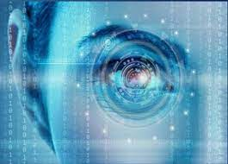
BLUE EYES TECHNOLOGY
Presented by,
Robin Bharathi.R
22bsc146

Slide 2
CONTENTS
Introduction
Why Blue eyes?
Technologies Used
Applications
Advantages & Disadvantages
Conclusion
References

Slide 3
Introduction
The term Blue eyes is coined because “blue”-Bluetooth
“eyes”- Eye Movements “technology”- techniques.
The BLUE EYES technology:
Aims at creating computational machines that have
perceptual and sensory ability like human beings.
Uses non-obtrusive sensing method in modern video
cameras and microphones to identify the user’s
actions through the use of imparted sensory
Understands the user’s wants, where he is looking
at, and even realize his physical or emotional states.

Slide 4
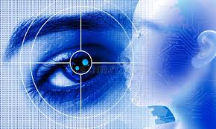
Why Blue Eyes?
The main objective of blue eyes is to design and
develop smarter devices also,by creating devices
with help of emotional intelligence.
ie; A pc that can listen, talk or scream.

Slide 5

To built a machine that can understand your
emotions and To avoid and reduce human
limitations such as:
• Tiredness
•Oversight
•Mental illness

Slide 6
TECHNOLOGIES USED
Blue Eyes system consists of a mobile measuring
device integrated with Bluetooth module providing
wireless interface between sensors worn by the
operator and the central unit.
The operators and adequate user profiles on the
central unit side provide necessary data
personalization so the system consists of:
Mobile measuring device (DAU)
Central System Unit (CSU)
The Hardware

Slide 7
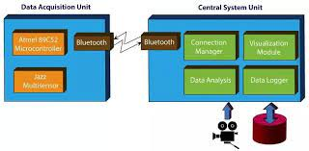
Mobile measuring device (DAU)-
Data Acquisition Unit is a mobile part of Blue eyes system
that is used to fetch the physiological data from the
sensor and send it to the central system to be processed.

Slide 8
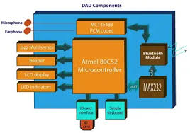
The DAU consist of the following components:
• BLUE TOOTH MODULE
–supports synchronous voice
• data transmission
• central system sound
feedback
• ALPHAUNUMERIC LCD
display
• LED indicators
• ID CARD interface

Slide 9
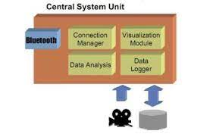
Central System Unit (CSU)
Central System Unit hardware is the second peer of the
wireless connection. The box contains a Bluetooth
module (based on ROK101008) and a PCM codec for
voice data transmission. The module is interfaced to a
PC using a parallel, serial and USB cable

Slide 10
EMOTION COMPUTING
For Hand:
1) Emotion Mouse
2) Sentic Mouse
For Eyes:
1) Expression Glasses
2) Magic Pointing
3) Eye Tracking
For Voice:
1) Artificial Intelligence Speech Recognition

Slide 11
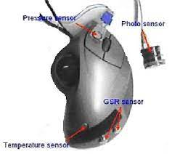
Emotion mouse
Emotion mouse sense the mood by analyzing pressure, temperature and heartbeat of the user and five types of mood can be sensed by computer.
How it works?
Like humans have five sense organs, emotion mouse is designed with five sensors to sense the different moods of user.

Slide 12
Artificial Intelligence Speech Recognition
AI is behavior of a machine, which, if performed by a
human being, would be called intelligent. It makes
machines smarter, useful and is less expensive than
natural intelligence.
Natural language processing (NLP) refers to AI
methods of communicating with a computer in a
natural language like English.
The input words are scanned and matched against
internally stored known words . In this way, one can
communicate with the computer in one’s language.
No special commands or computer language are
required.

Slide 13
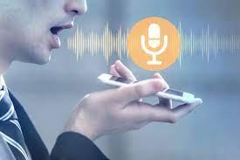
SPEECH RECOGNITION
The user speaks to the
computer through a microphone
As each word is spoken,
it is converted into binary
equivalent & stored in RAM. The computer then starts searching
and compares the binary input pattern with the templates.
The pattern matching process therefore uses statistical
techniques and is designed to
look for the best fit.

Slide 14
APPLICATIONS
In smart cameras and lie detector
In automobile industry.
In video games.
Military.
To create “Face Responsive Display” and
“Perceptive Environment” Generic control rooms.
At power station
At Flight Control Centers
Operating theatres

Slide 15
ADVANTAGES
Reduce manual work.
Physiological condition monitoring
Visual attention monitoring
High accuracy level
Fast in speed
Naturalness as compared to the old
traditional pointing
Less physical effort and stress as compared to
manual pointing

Slide 16
DISADVANTAGES
Not 100% accurate.
Expensive
System is bulky, need some minimization

Slide 17
CONCLUSION
The BLUE EYE technology
Ensures a convenient way of simplifying the
life by providing more delicate and user
friendly facilities in computing devices.
Gap between the electronic & physical world is
reduced
The computers can be run using implicit
command instead of the explicit commands.
Future applications of Blue Eyes technology
will be way ahead of other technologies.
The fields of advertisement and as they have
entertainment will be mostly benefited with
this an important role in our day to day life.

Slide 18
REFERENCES
[1] Kenneth Holmqvist, Marcus Nyström, Richard Andersson, Richard
Dewhurst, Halszka Jar-odzka, and Joost Van de Weijer. Eye tracking:
A comprehensive guide to methods and measures, Oxford University Press, 2011.
[2] Kenneth Holmqvist, Marcus Nyström, and Fiona Mulvey. Eye tracker data
quality: what it is and how to measure it. In Proceedings of the Symposium on Eye
Tracking Research and Applications, pages 45–52. ACM, 2012.
[3] Joseph j.carr & john m.brown, “introduction to blue eyes technology”,
published in ieee spectrum magazine.II. A.jajszczyk, “automatically switched
blue eyes networks :Benefits and Requirement,”
IEEE blue toooth.feb 2005,vol 3,no1,pp.

Slide 19
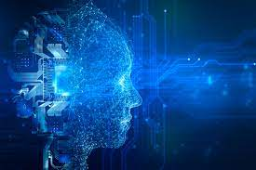
THANK YOU
Presented by,
Robin Bharathi.R
22bsc146

