Slide 1
Project Title : Programming Course Class (Web Application)
Candidate Name: Sainath bohare
Roll no: mc2123014
College name: imcost
Project Guide: Prof. Reeta Singh

Slide 2


One Roof Technology LLP
One Roof Technology LLP is leading tech house for corporates
Specialised in providing strategic and customized business
software solutions.
Website: www.onerooftech.com

Slide 3
About Project :
The Project is all about Recruit candidate who are interested to join our institute.
In this process candidate are able to apply via multiple ways such as –
Via Course website
Via Reference
Via Third Party(Any social media or PC-Class.com)

Slide 4
Hardware Requirements
Minimum 4GB RAM (6 GB Recommended)
Windows 10 operating system
32 GB Storage Memory
Processor – Dual core or Above

Slide 5
Software Requirements:
Development Tool - Visual Studio 2022/ VS Code
Web Browser – Mozzila Firefox, Google Chrome
Database - SQL Server Management Studio
OS – Windows-XP/ Later

Slide 6
Technology Used
Frontend
HTML , CSS , AJAX , JQUERY, JavaScript, Bootstrap, JSON
Backend
Asp.net , Web API , SQL, C#

Slide 7
Objective & Scope
The purpose of e-recruitment is to make recruiting processes more efficient and less expensive. And, by using e-recruitment, HR managers can reach a larger pool of potential employees and speed up the hiring process.
Also to save time of organization for organize separate scheduling and maintaining process physically as well as it saves the time of candidates of such as travelling time, finding location, waiting for appointment etc.
Maintaining Data of candidates physically is difficult so via E-Recruitment the data maintenance are getting cheap and more secured.

Slide 8
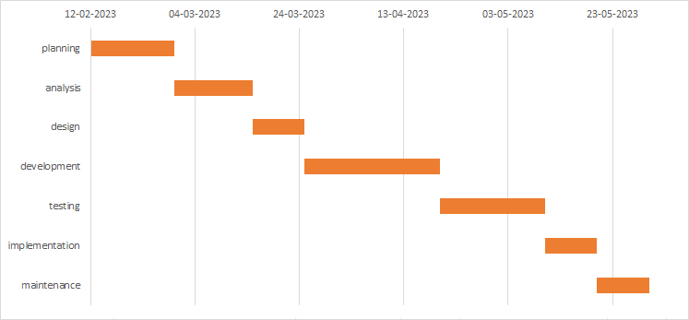
Gantt Chart

Slide 9
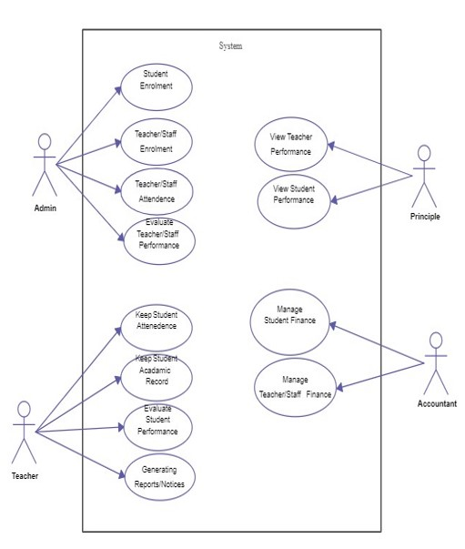

Slide 10
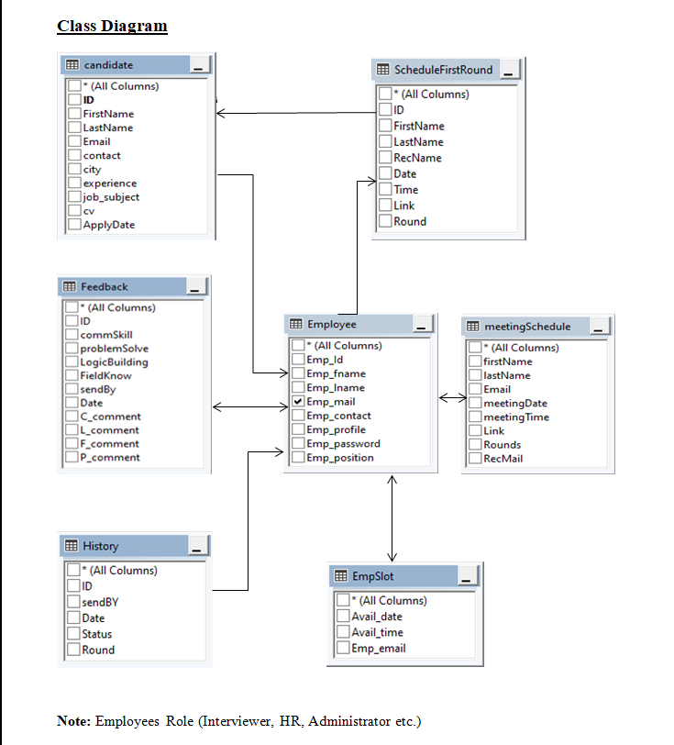

Slide 11
Project Modules
1. Sign Up Page
2. Login Page
3. Administrator Panel
4. Student Profile Page
5. HR Panel

Slide 12
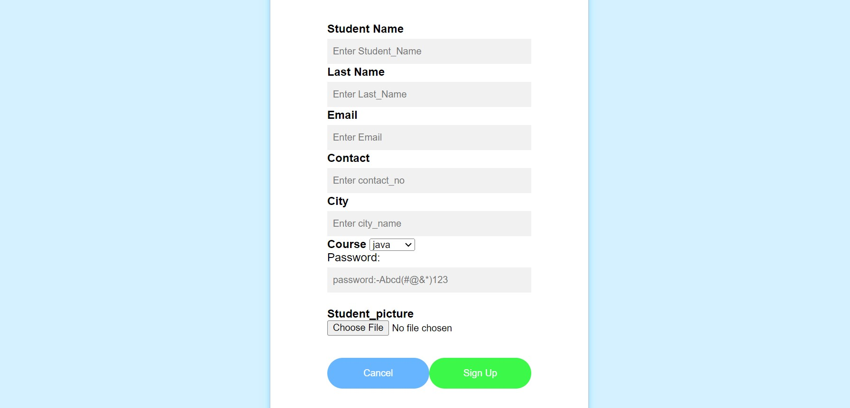
Sign Up Module

Slide 13
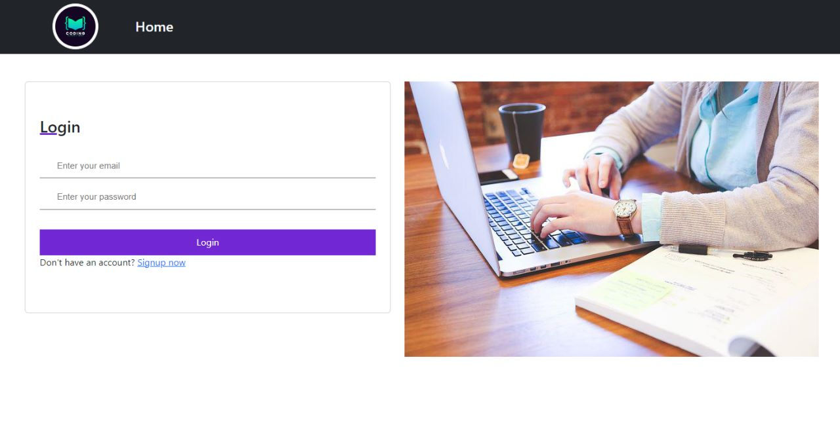
Login Module

Slide 14
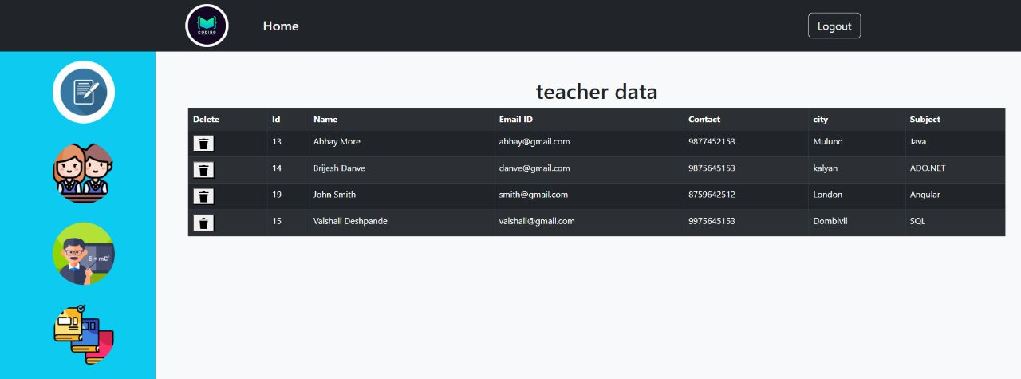
Administrator Panel

Slide 15
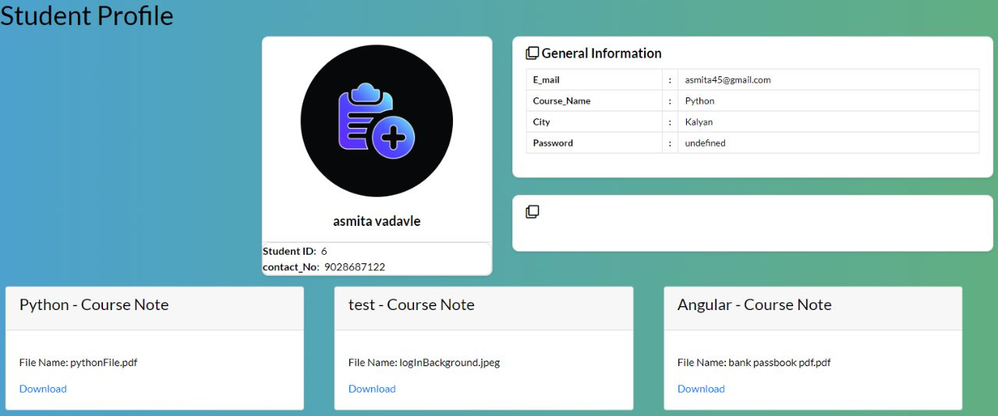
Student Panel

Slide 16
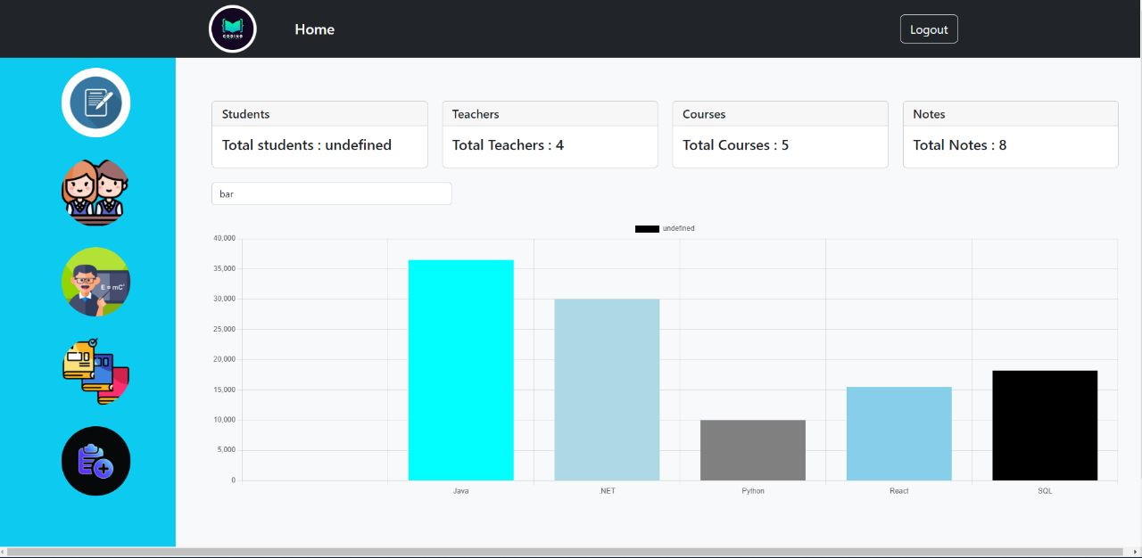
HR Panel

Slide 17
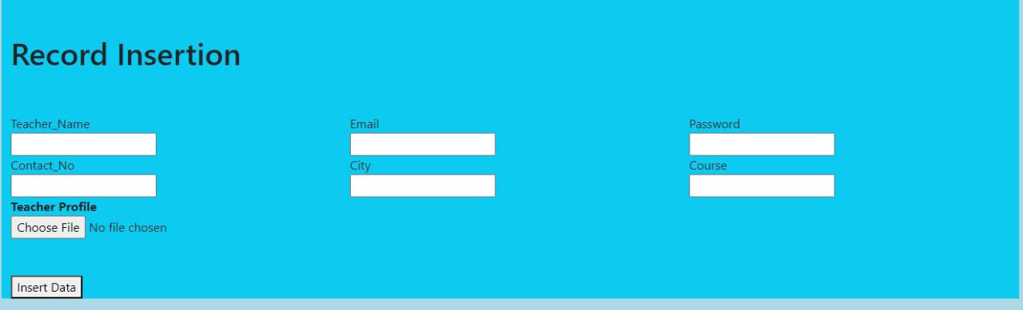
Staff Admission Scheduled

Slide 18
Project Structure
Home page
Sign up
Sign in
Admin Panel
Student Panel
HR Panel
User Management
Admission Form
Selected Course

Slide 19
Conclusion
The Goal of this project is to build .NET based Recruitment Process System, That includes Dynamics Team Meeting Creation and Auto Candidate Selection Notification via Email.
Also To increase better communication between Organization and Candidates.
Recruiters and Candidates have easy to use interface for better hiring system and this interface made the system easier to operate slashed the learning curved
Better categorized system for HR for better management

Slide 20
Thank You !

