Slide 1
Project Title :
Online Recruitment Process
(Web Application)
Candidate Name: Paresh DHANDE
Roll no: mc2122021
College name: imcost
Project Guide: Prof. Reeta Singh

Slide 2


One Roof Technology LLP
One Roof Technology LLP is leading tech house for corporates
Specialised in providing strategic and customized business
software solutions.
Website: www.onerooftech.com

Slide 3
About Project :
The Project is all about Recruit candidate who are interested to join our Organization.
In this process candidate are able to apply via multiple ways such as –
  Via company website
  Via Reference
  Via Third Party (LinkedIn or Nuakri.com)

Slide 4
Hardware Requirements
  Minimum 4GB RAM (6 GB Recommended)
  Windows 10 operating system
  32 GB Storage Memory
  Processor – Dual core or Above

Slide 5
Software Requirements:
  Development Tool - Visual Studio 2022/ VS Code
  Web Browser – Mozzila Firefox, Google Chrome
  Database - SQL Server Management Studio
  OS – Windows-XP/ Later

Slide 6
Technology Used
  Frontend
  HTML , CSS , AJAX , JQUERY, JavaScript, Bootstrap, JSON
  Backend
  Asp.net , Web API , SQL, C#

Slide 7
Objective & Scope
The purpose of e-recruitment is to make recruiting processes more efficient and less expensive. And, by using e-recruitment, HR managers can reach a larger pool of potential employees and speed up the hiring process.
Also to save time of organization for organize separate scheduling and maintaining process physically as well as it saves the time of candidates of such as travelling time, finding location, waiting for appointment etc.
Maintaining Data of candidates physically is difficult so via E-Recruitment the data maintenance are getting cheap and more secured.

Slide 8
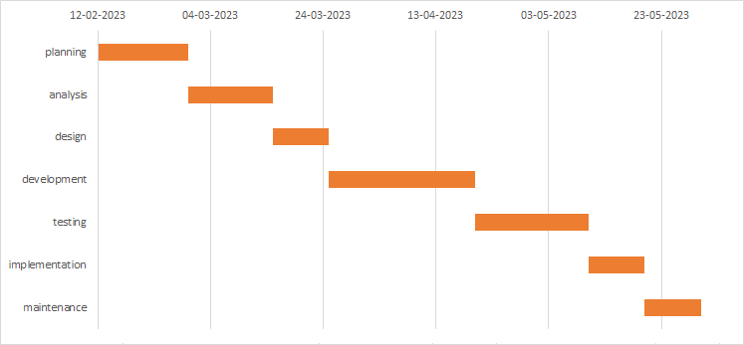
Gantt Chart

Slide 9
Project Modules
1. Sign Up Page
2. Login Page
3. Administrator Panel
4. Employee Profile Page
5. HR Panel
6.Meeting Schedule

Slide 10
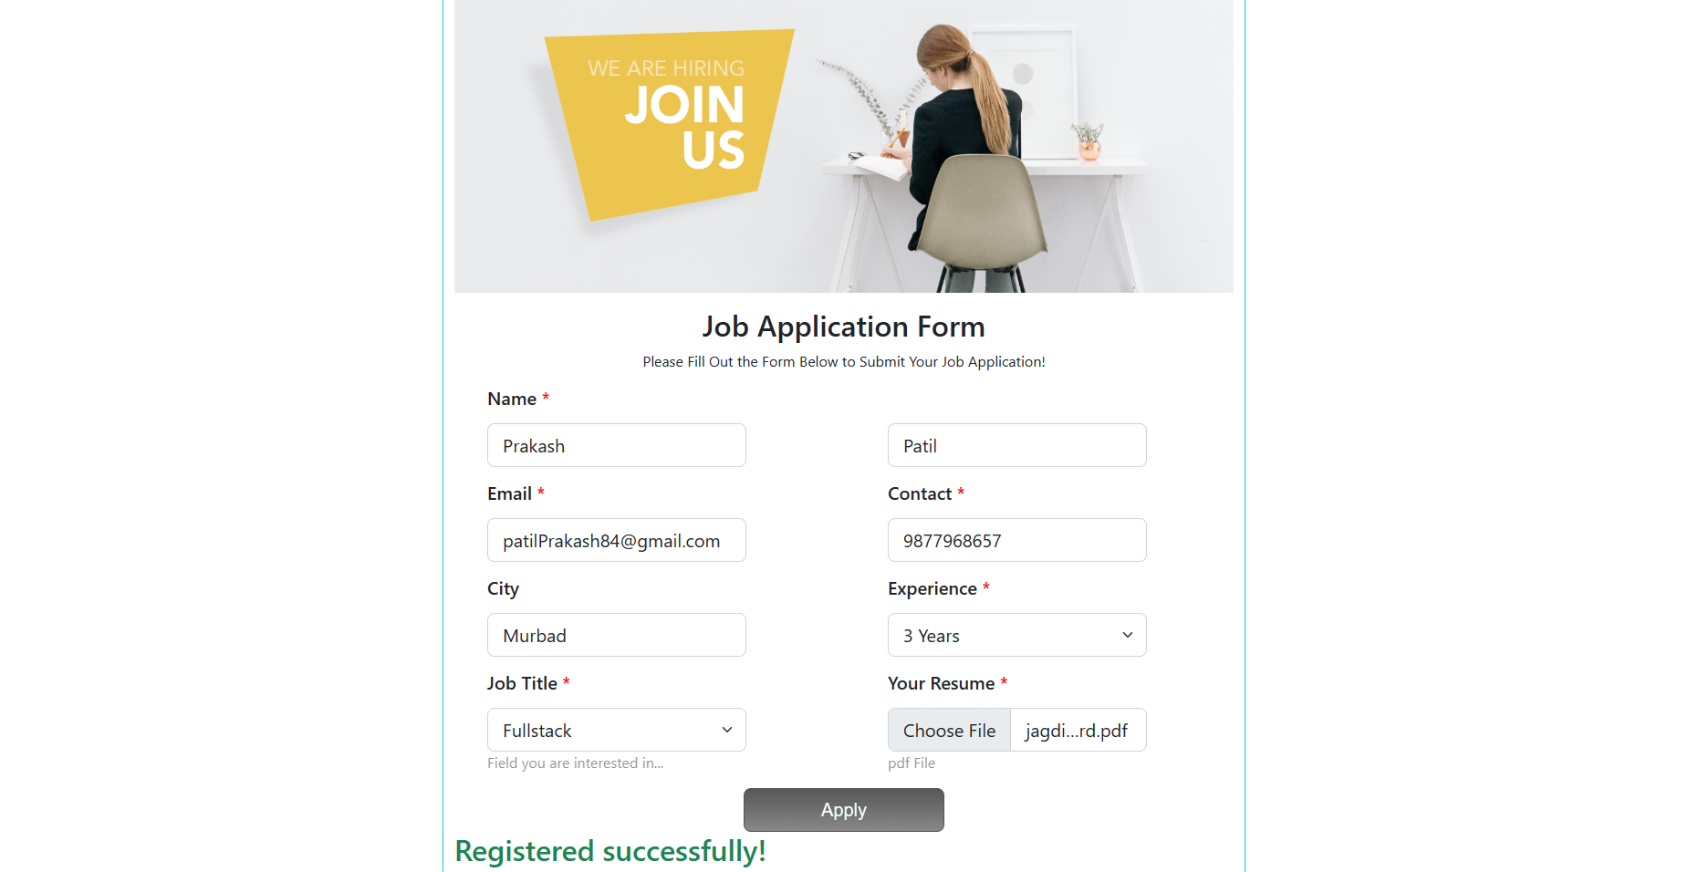
Sign Up Module

Slide 11
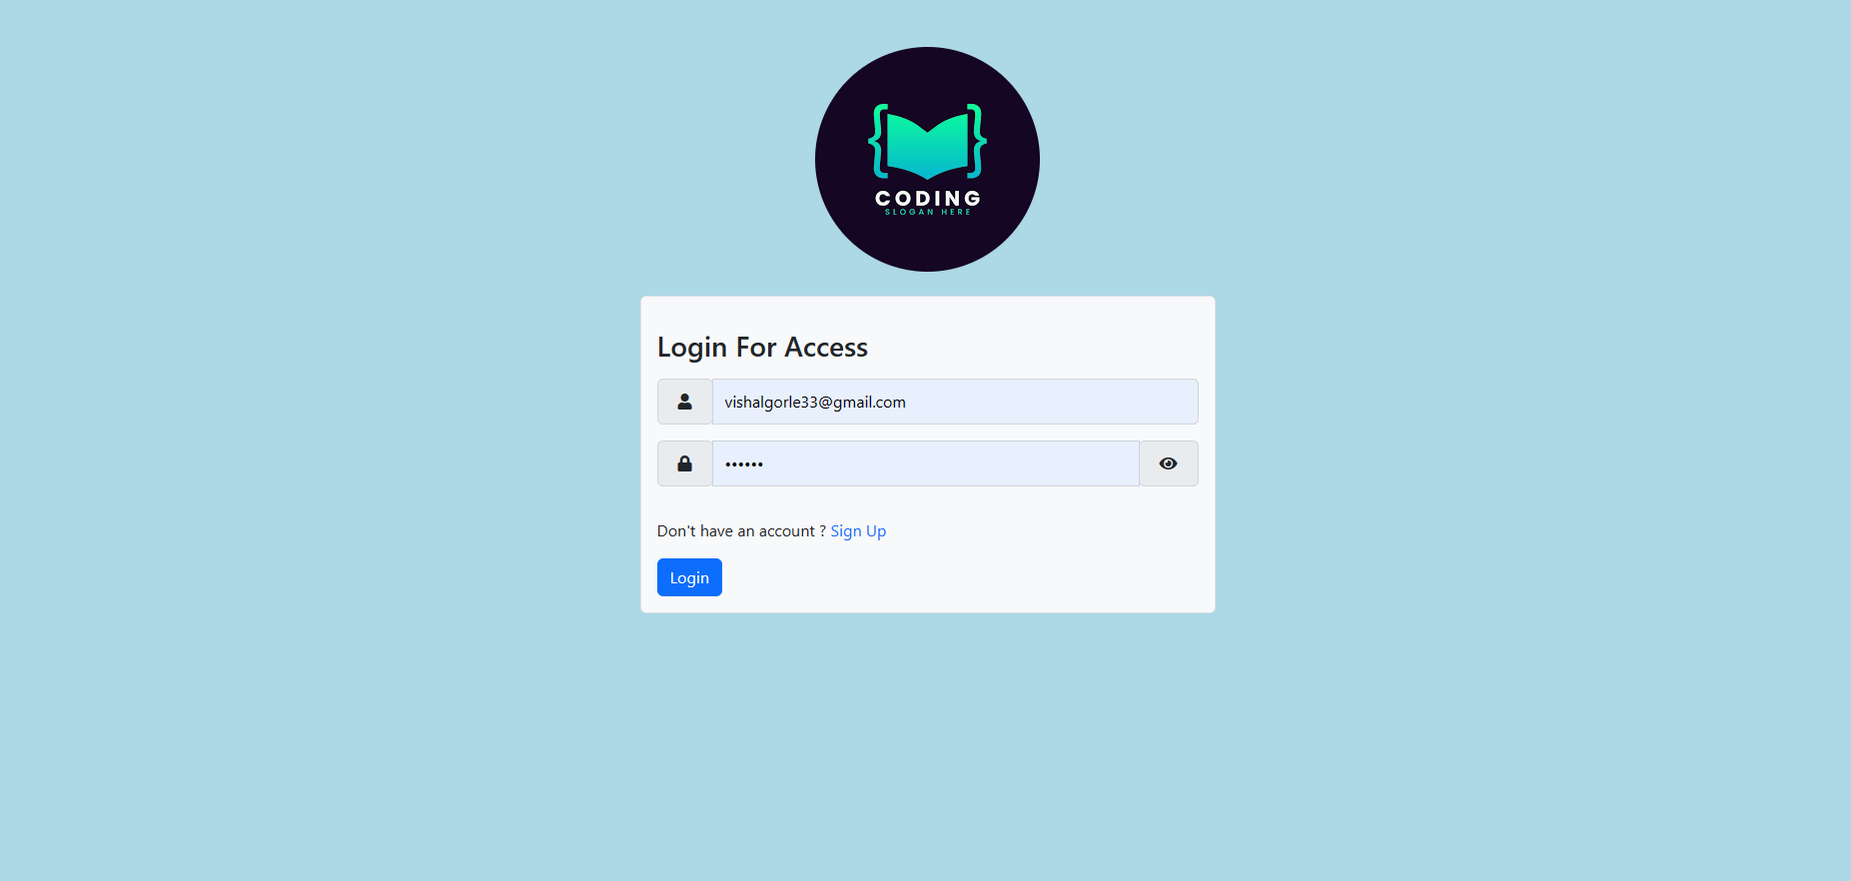
Login Module

Slide 12
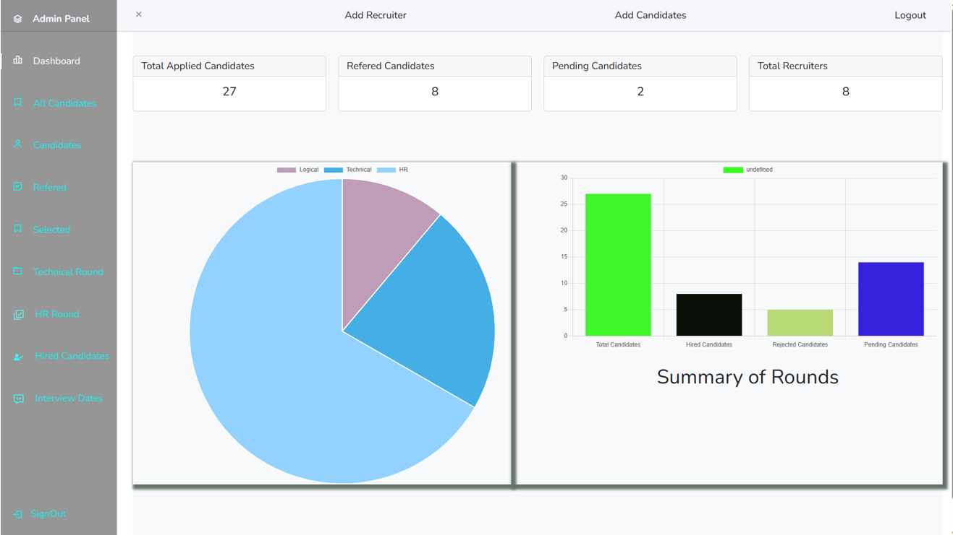
Administrator Panel

Slide 13
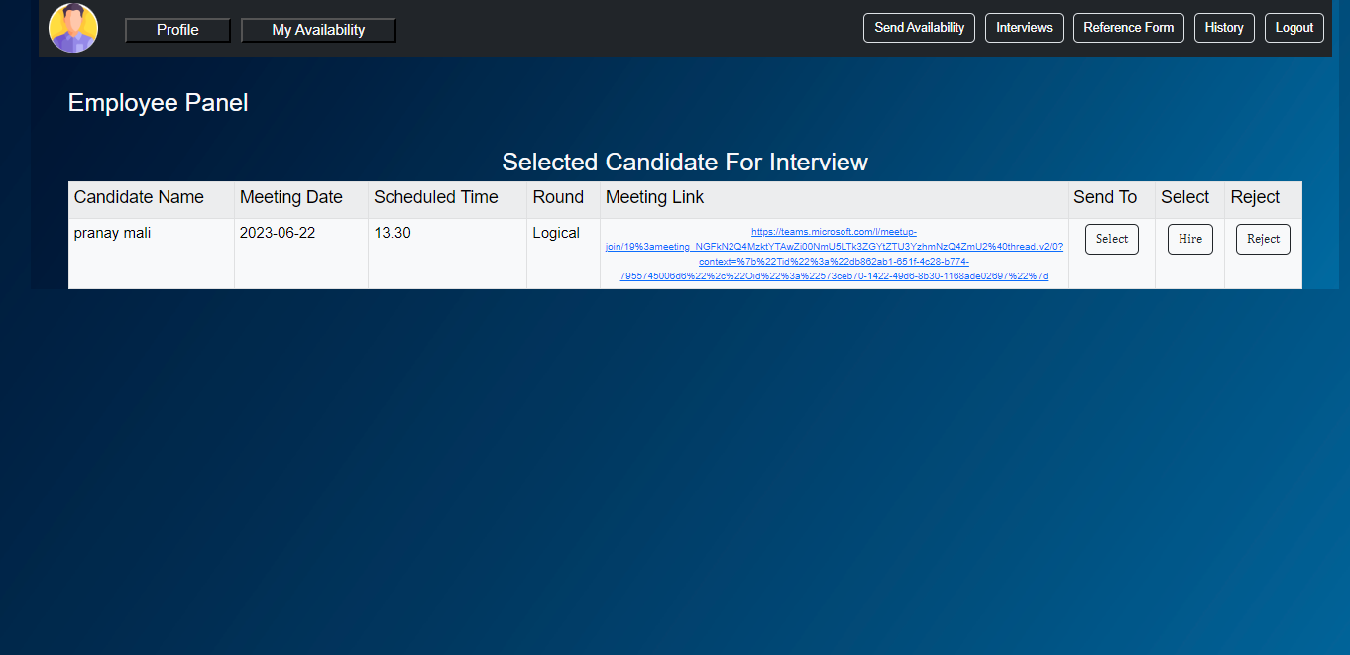
Employee Panel

Slide 14
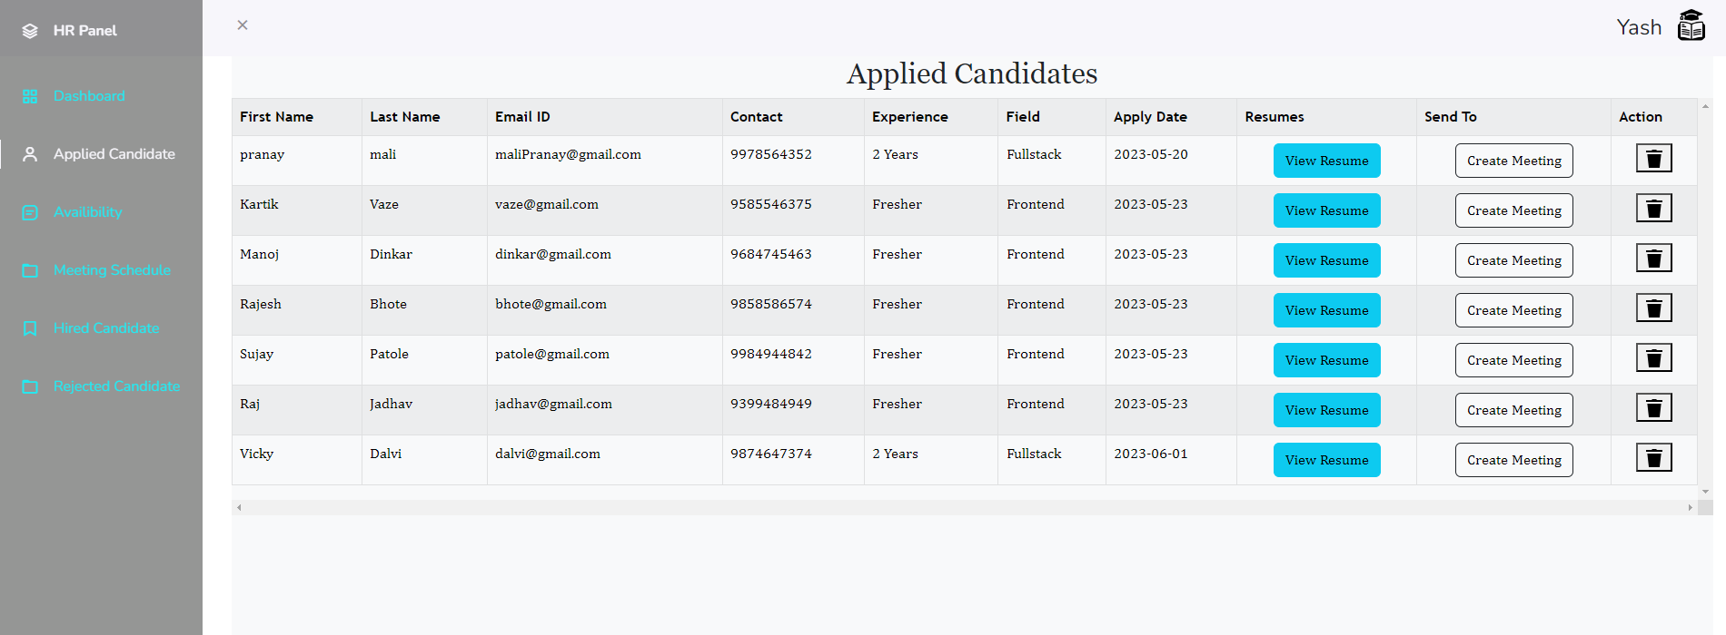
HR Panel

Slide 15
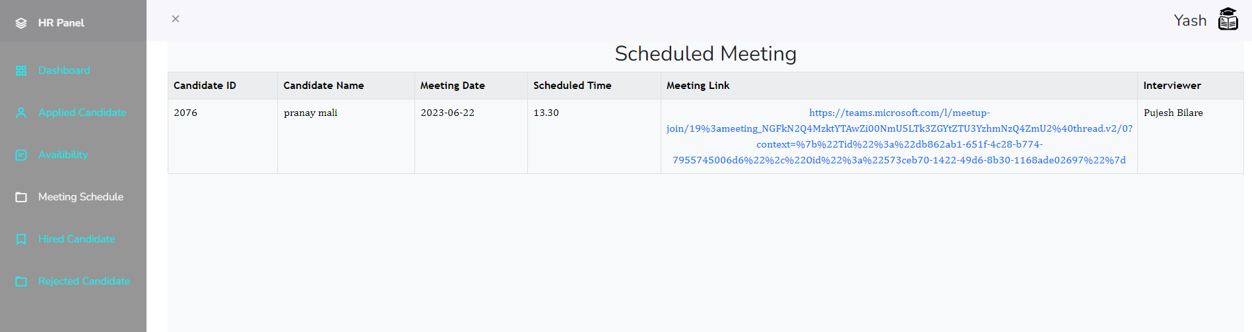
Meeting Scheduled

Slide 16
Project Structure
Home page
Sign up
Sign in
Admin Panel
Employee Panel
HR Panel
User Management
Reference Form
Selected Candidate

Slide 17
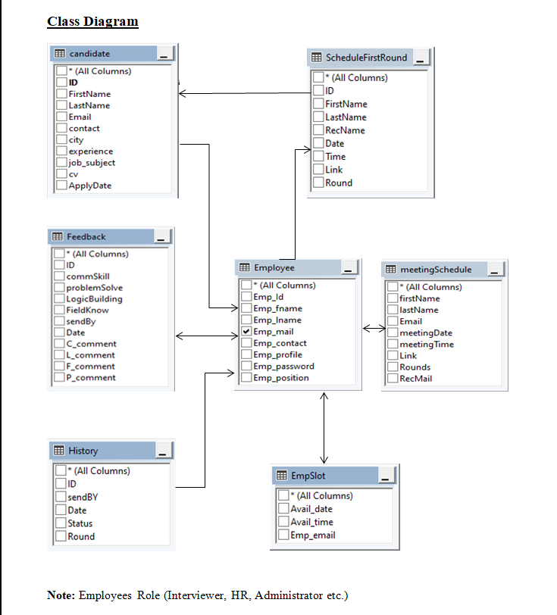

Slide 18
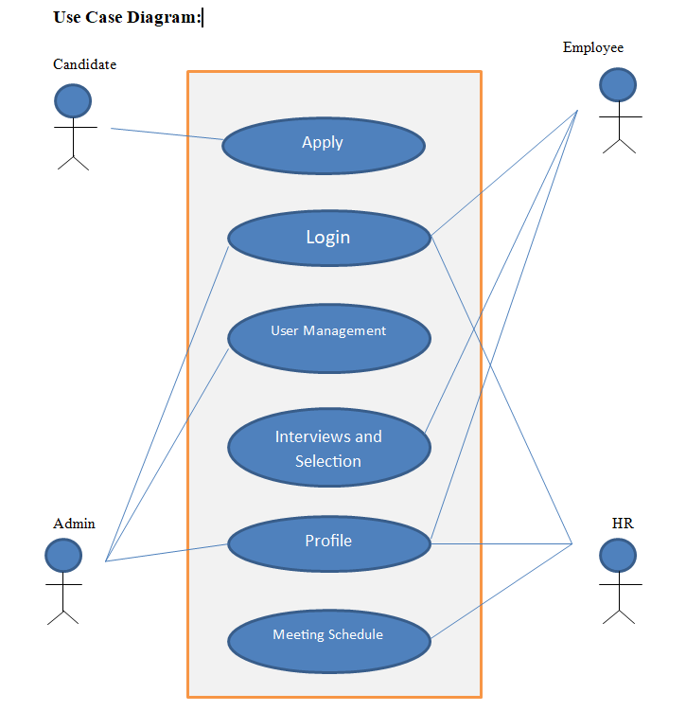

Slide 19
Conclusion
The Goal of this project is to build .NET based Recruitment Process System, That includes Dynamics Team Meeting Creation and Auto Candidate Selection Notification via Email.
Also To increase better communication between Organization and Candidates.
Recruiters and Candidates have easy to use interface for better hiring system and this interface made the system easier to operate slashed the learning curved
Better categorized system for HR for better management

Slide 20
Thank You !

